Slide 1



EU-AFD TECHNICAL ASSISTANCE PROGRAMME TO SUPPORT
REFORMS IN THE WATER AND WASTEWATER SECTORS
IN LEBANON
WATER SECTOR COORDINATION
January 2023

Slide 2

01. Mission Statement and Specific Objectives
The Sector coordination mechanism will work towards enhanced coordination in order to maintain coherence, avoid duplication and promote complementarity of intervention.
Endorsing strategic orientations and sector guidelines approved by the authorities
Following up on the implementation of the reforms
Monitoring and mapping of interventions and analysis of gaps (complementarity)
Adopting recommendations / sector guidelines of the strategy and the recovery plan for future interventions
Strengthening communication and information sharing (facilitating advocacy)
Enhancing accountability, transparency and participation
Working closely with cross-cutting thematic groups i.e. WASH, 3RF, etc.
Identifying working groups on specific topics if and as need be

Slide 3
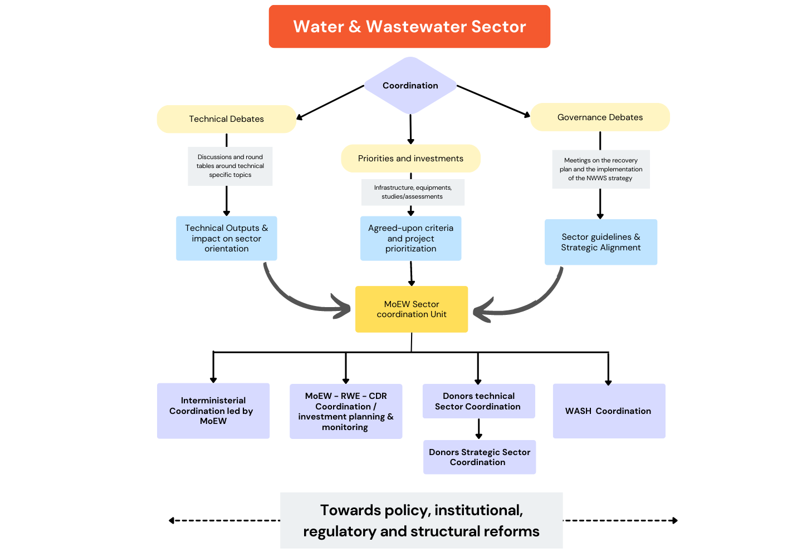
02. Coordination
Framework

Slide 4
03. Structure / Membership
Interministerial Coordination
Led by the MoEW
Coordination / Investment planning & monitoring
Led by the MoEW
Members ➔ MoE, MoA, MoI, MoPH, MoPW, MoIM, MoF, MoT, MoET
Objectives➔ Strategic planning, water allocation, alignment on relevant reforms
Members ➔ RWE, CDR and LRA (depending on the geographical coverage of the project)
Frequency ➔ Quarterly or Ad-hoc basis
Frequency ➔ Quarterly or Ad-hoc basis
Objectives➔ enhancing dialogue, investment planning, supporting WEs in monitoring projects in their region, reviewing projects and alerting, if necessary, the CDR and the MoEW on foreseen issues that might affect the operational phase of the project.

Slide 5
03. Structure / Membership
Donors Technical Sector Coordination
WASH Coordination
Led by the MoEW
Members ➔ WASH partners (LNGO’s UN agencies, INGO’s)
Objectives ➔ responding to emergencies, coordinating field activities, etc.
Led by the MoEW
Frequency ➔ Quarterly or Ad-hoc basis
Objectives➔ Sharing sectoral monitoring data; Defining measurable and time bounded engagements from all parties towards reforms; determining gaps; promoting complementarity
Members: RWE; Donors and UN Agencies active in the water sector; representative/ coordinator of the WASH sector; Representative of NGOs from the WASH sector
Frequency ➔ Monthly

Slide 6
03. Structure / Membership
Other direct and indirect stakeholders/actors could be included such as the Ministry of Agriculture (when it comes to irrigation), the Ministry of Environment (when it comes to environmental protection) and the Litani River Authority according to the needs.
The EU-AFD TA Programme will ensure, for the period of implementation of the project, three main support functions:
  Act as a policy, technical and advisory group and coordinate with relevant stakeholders as need be;
  Ensure the secretariat of the donors sector coordination;
  Relay information for communication about the reform process discussed in these coordination meetings.
Ad-hoc meetings may be called by the Ministry in agreement with the members, or at the request of three other members, when this is considered necessary to address an issue of urgent matter. However, this request shall be priory validated by the MoEW and in consultation with the members.

Slide 7
04. Debates / Working group modalities
The technical / governance debates shall bring together professionals to network and discuss hot and specific topics in the water and wastewater sector.
An additional layer of coordination will be dedicated to the discussions on priorities and investments in the water and wastewater sector in order to explore opportunities for coordination and joint working.
Propositions from other sector actors or indirect stakeholders would be received in a dedicated repository (consultants, contractors, civil society, ministries, NGOs) to put forth burning issues for the attention of the different committees.
The identification of the leading body/agency will be concerted with the MoEW depending on the topic and the availability.
Invitations for water sector debates are sent out via a mailing list by the lead body. The WASH sector is encouraged to promote debates in their network.
The EU-AFD Programme will build on the existing mechanisms for cross-sector , cross-theme, cross-
establishment, and within-sector coordination mechanisms to support its water reform program.

Slide 8
05. Imminent Technical Topics for Coordination / Discussion
Water Source Monitoring
Updating Customer Database
Collaboration with Municipalities
Solarization
Water Quality
Data Center at the MoEW
Other ?

Slide 9
06. MoEW - Sector Monitoring & Evaluation
A digital mapping tool will be disseminated to all sector partners by the MoEW.
It shall help visualizing all the interventions in the sector and ensure coherence with national strategy and recovery plan approved and endorsed by the authorities.
It would also help proper planning of investments in the sector to cope with the needs while avoiding overlaps and encourage coordination on projects.
An impact assessment / evaluation shall be conducted for each project (especially for infrastructure). Results shall be introduced to the mapping tool.

Slide 10
Thank you
for your attention
Questions?

