Slide 1




EU-AFD TECHNICAL ASSISTANCE PROGRAMME TO SUPPORT
REFORMS IN THE WATER AND WASTEWATER SECTORS
IN LEBANON
Tariff Level and Tariff Structure
January 20, 2023

Slide 2
Tariff level vs. tariff structure
Tariff level
It is the lynchpin tariff for a m3/day subscription. It is targeting the financial equilibrium of the business which is far from being the case in Lebanon presently
Tariff structure
While tariff structure is addressing the various combination of the tariffs per category or per volume subscribed in order to reach the equilibrium and to introduce some kind of fairness among customers.

Slide 3


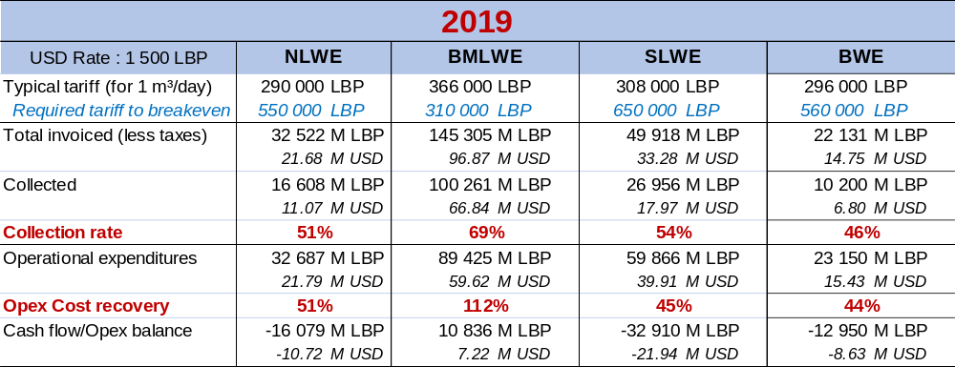
Tariff level
The Pre-Crisis situation
The level of service in 2019 was acceptable
The financial situation of the WEs was not so bad : Improving the collection rates would have nearly achieved financial equilibrium.

Slide 4
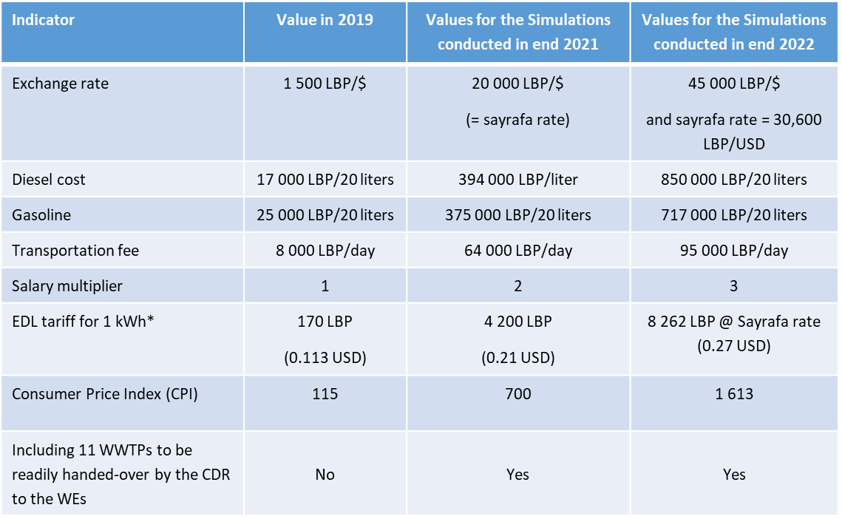

Tariff level
Opex calculation issue
INPUT DATA ADOPTED (AS PER MoEW ASSUMPTIONS)
After 2019, the level of services provided by the WEs decreased gradually, which is reflected in the WEs operation expenditures.
Opex calculation is based on actual financial indicators

Slide 5
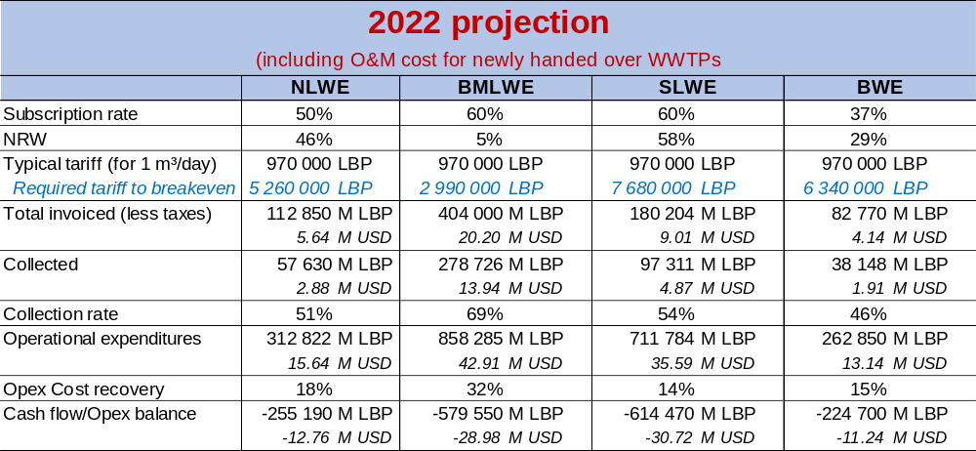
Tariff level
Breakeven tariff simulations
Considering the lower EDL tariff

Slide 6
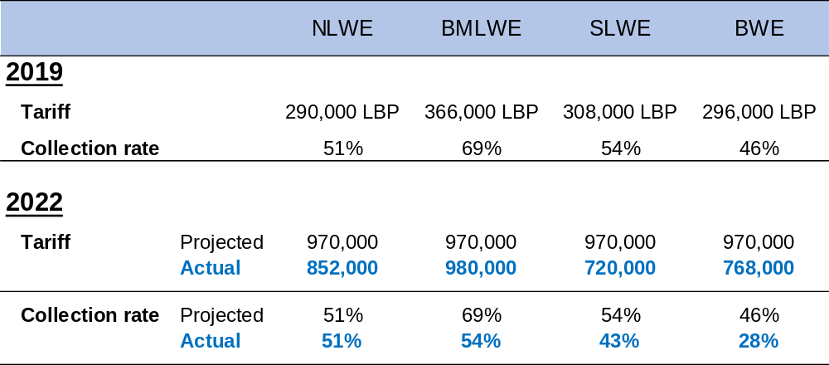
Tariff level
Financial crisis overtaking forecasts

Slide 7
Tariff level
Cost Recovery Simulation Per WE Showing Breakeven Tariffs
 | NLWE | BMLWE | SLWE | BWE
Annual tariff (2023) | 2 540 000 LBP | 3 860 000 LBP | 3 245 000 LBP | 2 475 000 LBP (Proposed)
Collection rate (2022) | 51 % | 54 % | 43 % | 28 %
Breakeven tariff (2023) | 8 500 000 LBP | 5 500 000 LBP | 33 000 000 LBP | 17 000 000 LBP
Even with an additional tariff increase in 2023 for a weighted national average of 3,600,000 LBP/m³/yr
The sector would still accumulate an additional total deficit of 76,5 Million USD

Slide 8
Tariff level
Proposed tariff gradual increase
Increase in revenues of the WEs through a gradual yearly raise in tariff starting at starting at around 0,89 MLBP in 2022 (equivalent to around 20 USD on adopted exchange rate ) up to 6,7 MLBP (equivalent to 150 USD on adopted exchange rate) in 2026.
This increase is expected to be accompanied with an improvement of the collection and subscription rates addressed in the commercial actions.
Year | 2019 | 2022 | 2023 | 2024 | 2025 | 2026
Tariff | 220 USD (330 k LBP) | 20 USD (890 k LBP) | 80 USD (3.6 M LBP) | 100 USD (4.5 M LBP) | 120 USD (5.4 MLBP) | 150 USD (6,7 MLBP)

Slide 9
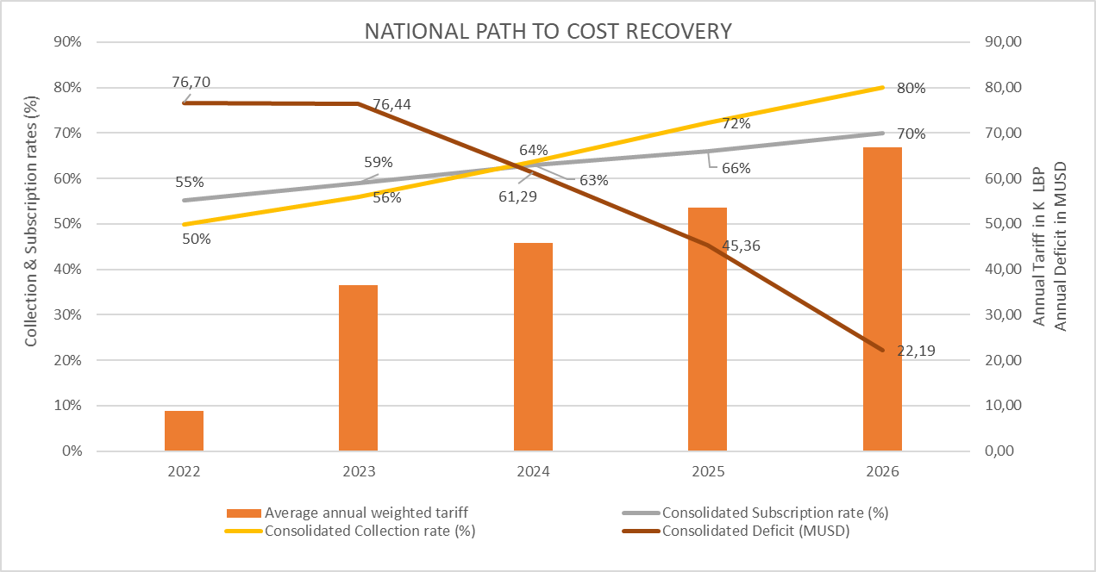
Tariff level
PATH TO COST RECOVERY

Slide 10
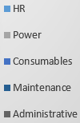
Tariff level
Foreseen consolidated OPEX distribution for the 4 WEs
2023

Slide 11
Tariff structure
The existing tariff structure
The flat rate basis
The billing is annual
Subscribers are charged regardless of the category
Rationale is volume subscribed/day x 365 x rate in L.L.
Some fixed fee (maintenance of gauge fee)

Slide 12
Tariff structure
What are the pros and cons?
Advantage
Inconvenient
It is straightforward easy to understand
No water meter reading
Billing exercise is easy whenever compared with meters reading which requires specific software and double checking of the water meters index reading before producing the bill.
Linked to the gauge system which is inaccurate and is an incentive not to save the water.
No discrimination among the final use of the water (Domestics, commercials, industrials, governmental, parastatals)
vs.

Slide 13


Tariff structure
The what if exercise
Discriminate the tariff per category
  Namely : Domestics, Industrials/commercials, Governmental/Parastatals
A limited progressiveness for domestics
  The rationale is to introduce a multiplier for subscription > 1m³. The overwhelming majority of the customers are falling into the 1 m³/day category
Methodology used is to simulate what would have been the revenues receivables for 2021 if the proposed change had been introduced for the fiscal year.

Slide 14
Tariff structure
What are the multipliers used?
Water Establishment | Category | Multiplier Used
SLWE ,NLWE , BWE | Domestics | x 2 for subscribers > 1m³
 | Industrials/commercials | x 2
 | Governmental/parastatals | x 1.5
Customer data base of BMLWE does not provide categories
BMLWE | Option 1 | x 2 for subscribers > 1m³
 | Option2 | x 2 for subscribers between 2m³ and 50m³ x 3 for subscribers > 50m³

Slide 15




Tariff structure
The impact on receivables
Domestics
Industrials Commercials
Governmental Parastatals
Total Gains
NLWE
+14%
+100%
+50%
+15%
All Categories
SLWE
+9%
+100%
+50%
+11%
All Categories
BWE
+14%
+100%
+50%
+16%
All Categories
Together
+12%
+100%
+50%
+14%
All Categories
Notes:
A weighted average

Slide 16




Tariff structure
The impact on receivables
Domestics
Industrials Commercials
Governmental Parastatals
Total Gains
BMLWE
Option 1
No categories
+35 %
Option 2
No categories
+42 %
Simulation does not take into account a cleaning of the data base with proper allocation of subscribers in the right categories. Such exercise would certainly boost the total impact.

Slide 17
Tariff structure
The sensitivity analysis & impact on receivables
The specific cases of NLWE, SLWE, BWE
 | WEs | Multiplier(s)
Domestics |  | 2 | 1,8 | 1,5 | 1,8
Industrials |  | 2 | 2 | 1,8 | 2,1
Governmental |  | 1,5 | 1,5 | 1,5 | 1,5
Additional revenues % | BWE | 16% | 14% | 9% | 14%
Additional revenues % | NLWE | 15% | 12% | 8% | 12%
Additional revenues % | SLWE | 11,4% | 9,6% | 6,6% | 9,9%
Notes:
Préparer une analyse de sensibilité pour la présentation de janvier

Slide 18
Tariff structure
The sensitivity analysis & impact on receivables
The specific case of BMLWE
Option 1 |  | Option 2
Multiplier | Additional revenues % | Multiplier | Additional revenues %
1,5 | 18% | 1,5 +2 | 22%
1,8 | 29% | 1,8 + 2 | 30%
2 | 36% | 2 + 3 | 43%
2,1 | 39% | 2,1 + 3 | 46%
Notes:
Préparer une analyse de sensibilité pour la présentation de janvier

Slide 19
Tariff structure
Main outcome of the exercise
Introducing such change in the tariff structure is worthwhile. In other words: it pays off.
The impact is very high in BMLWE and less significant in the other WEs. The reason being
    - Multipliers are not the same while BMLWE has a special multiplier for the big customers (x3), the other WEs are only (x2).
    - The distribution of customers is wider in BMLWE with high number of customers who subscribed more than 1m³/day.
The simulations conducted do not take into account the additional benefits as derived from the cleaning of the customer data-base exercise. Such exercise would certainly conduct to proper allocation of subscribers in the proper categories and the cascading additional revenues.
Such change can possibly be gradually introduced for a smooth transition.
Figures as proposed are reference only and are to be discussed before being fine tuned
The social consideration has been taken into account with the no impact on small subscriptions.

Slide 20
Tariff structure
The simulation exercise main findings
WE
Specificities to be addressed
NLWE
Number of subscription (13 000) which are < 1m³. This is not up to modern pattern of consumption and source of commercial losses for the WE.
Number of subscribers registered in wrong categories (Hotels for instance)
BMLWE
No categorization of customers.
BWE
Number of subscribers is low whenever compared with standards and population in the service area.
SLWE
Problem with categorization.

Slide 21
Listing of prospects for tariff review
Simplified action plan in relation with tariff & customer management
Actions | Short content | Expected output | Status
Increase the collection rate | Set up a special cell responsible for: Design and enforce the billing/collecting master sheets Monitoring of the collection of the monies for each category of customers Monitors the collection rates and payment deadlines after 1, 3 months Address the issue of unsettled bills, including legal actions and disconnection Public relation campaign addressing the issue of water bills settlement | Increase the treasury situation | Under consideration
Review/up-dating the customer data bases | Project includes Detection of anomalies Detection of frauds and possible illegal connections Review of customers’ categories Conduct random studies on proper subscription in relation with the size of the premises Define the target zone for conducting a systematic customer census. Revocation of all subscription < 1m³ (Specific case of Tripoli) Specific case of BMLWE (no category) | Increase the accuracy and reliability of the customers data base and increase revenues of the WEs. | In the pipeline

Slide 22
Listing of prospects for tariff review
Simplified action plan in relation with tariff & customer management
Actions | Short content | Expected output | Status
A possible change in the tariff structure. | Prepare a financial simulation for each WEs whose objective is to highlight the impact of introducing the new tariff structure whenever compared with the revenues produced during fiscal year 2021. | A report + a PowerPoint presentation. | Finalized and awaiting feed back from the WEs for implementation
Big customers specific management | Set up a special unit within the customer management Dpt concentrating on big customers. (Threshold to be defined). The long-term objective is to introduce water meters for these customers together with a change in the billing periodicity. (From annual to quarterly) | Additional revenues for the WEs | Under consideration

Slide 23
Thank you
for your kind attention

