Slide 1




EU-AFD TECHNICAL ASSISTANCE PROGRAMME TO SUPPORT
REFORMS IN THE WATER AND WASTEWATER SECTORS
IN LEBANON
Water Sector Key Data and Performance Indicators
January 20, 2023

Slide 2
Outline
01
Master planning for water and wastewater
Metering and monitoring of water production and distribution
02
03
KPIs & performance framework
04
Strategic Planning, managing, and monitoring Tool

Slide 3
Master Planning

Slide 4


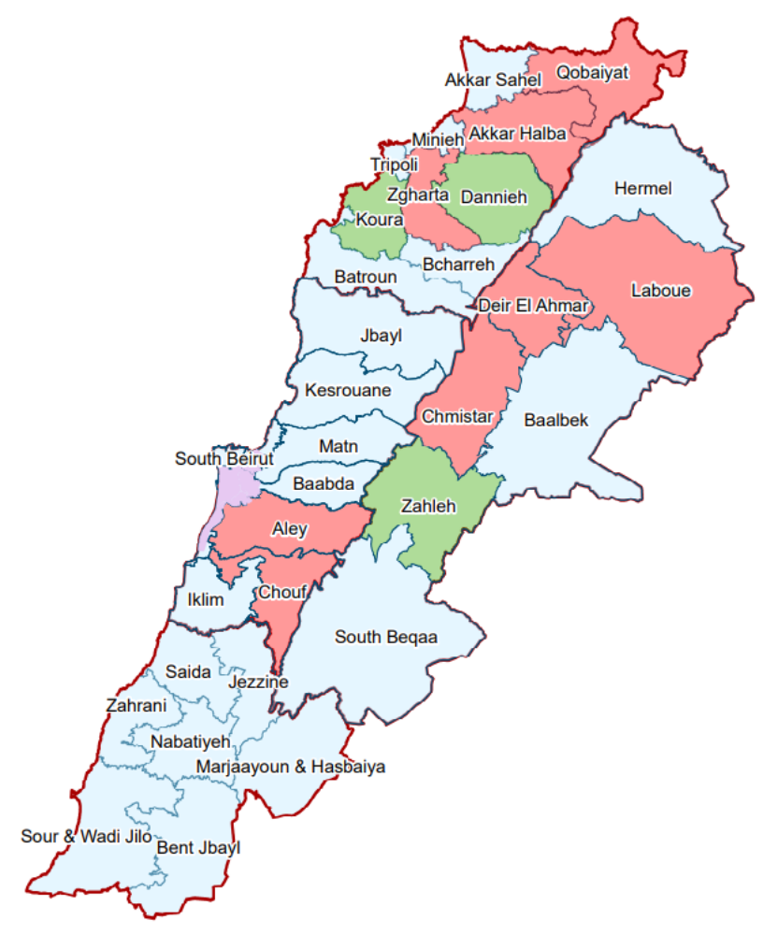
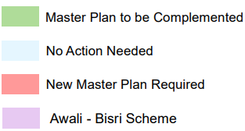




Water Master Planning
Present status
NLWE Partially covered
BMLWE fully covered except
- Chouf/Aley area, which is currently under study
- Areas intended to be supplied from dams that now are suspended or on hold
SLWE Fully covered
BWE Partially covered
Key issues
Prepare Master Plans for areas not addressed yet.
Bisri dam is intended to feed South Beirut and there is no other viable option.
Boqaata dam is intended to feed a large part of Matn by gravity, avoiding pumping from Jeita at a cost exceeding 3MUSD/year

Slide 5
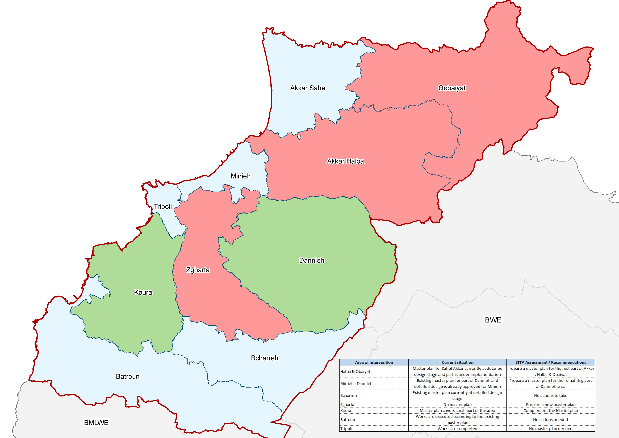

Slide 6
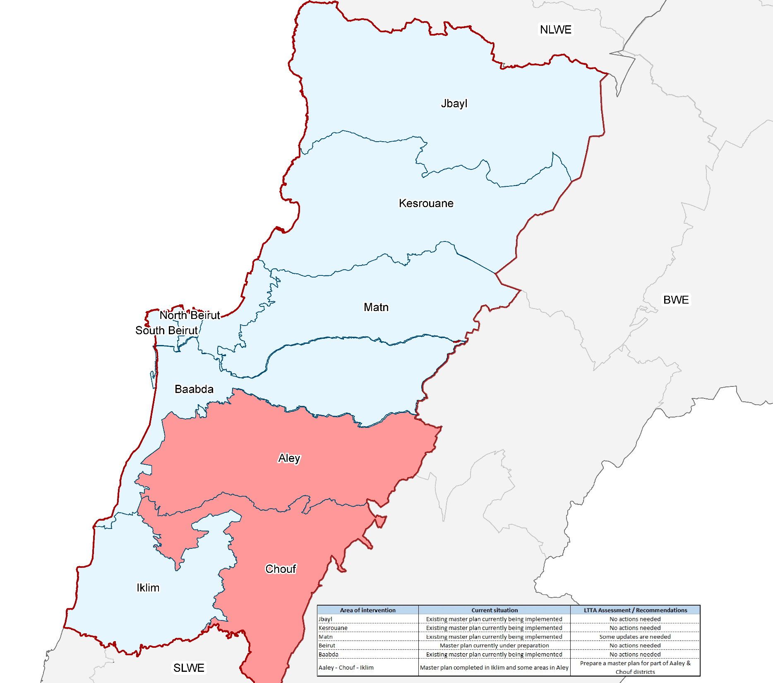

Slide 7
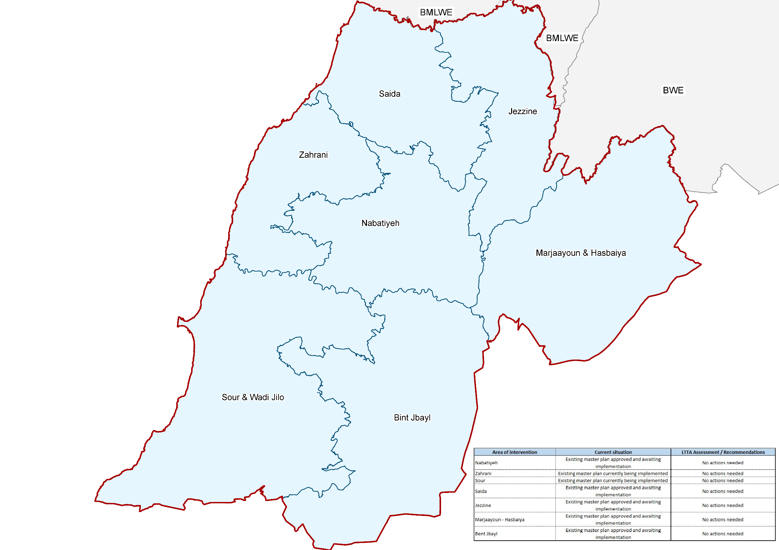

Slide 8
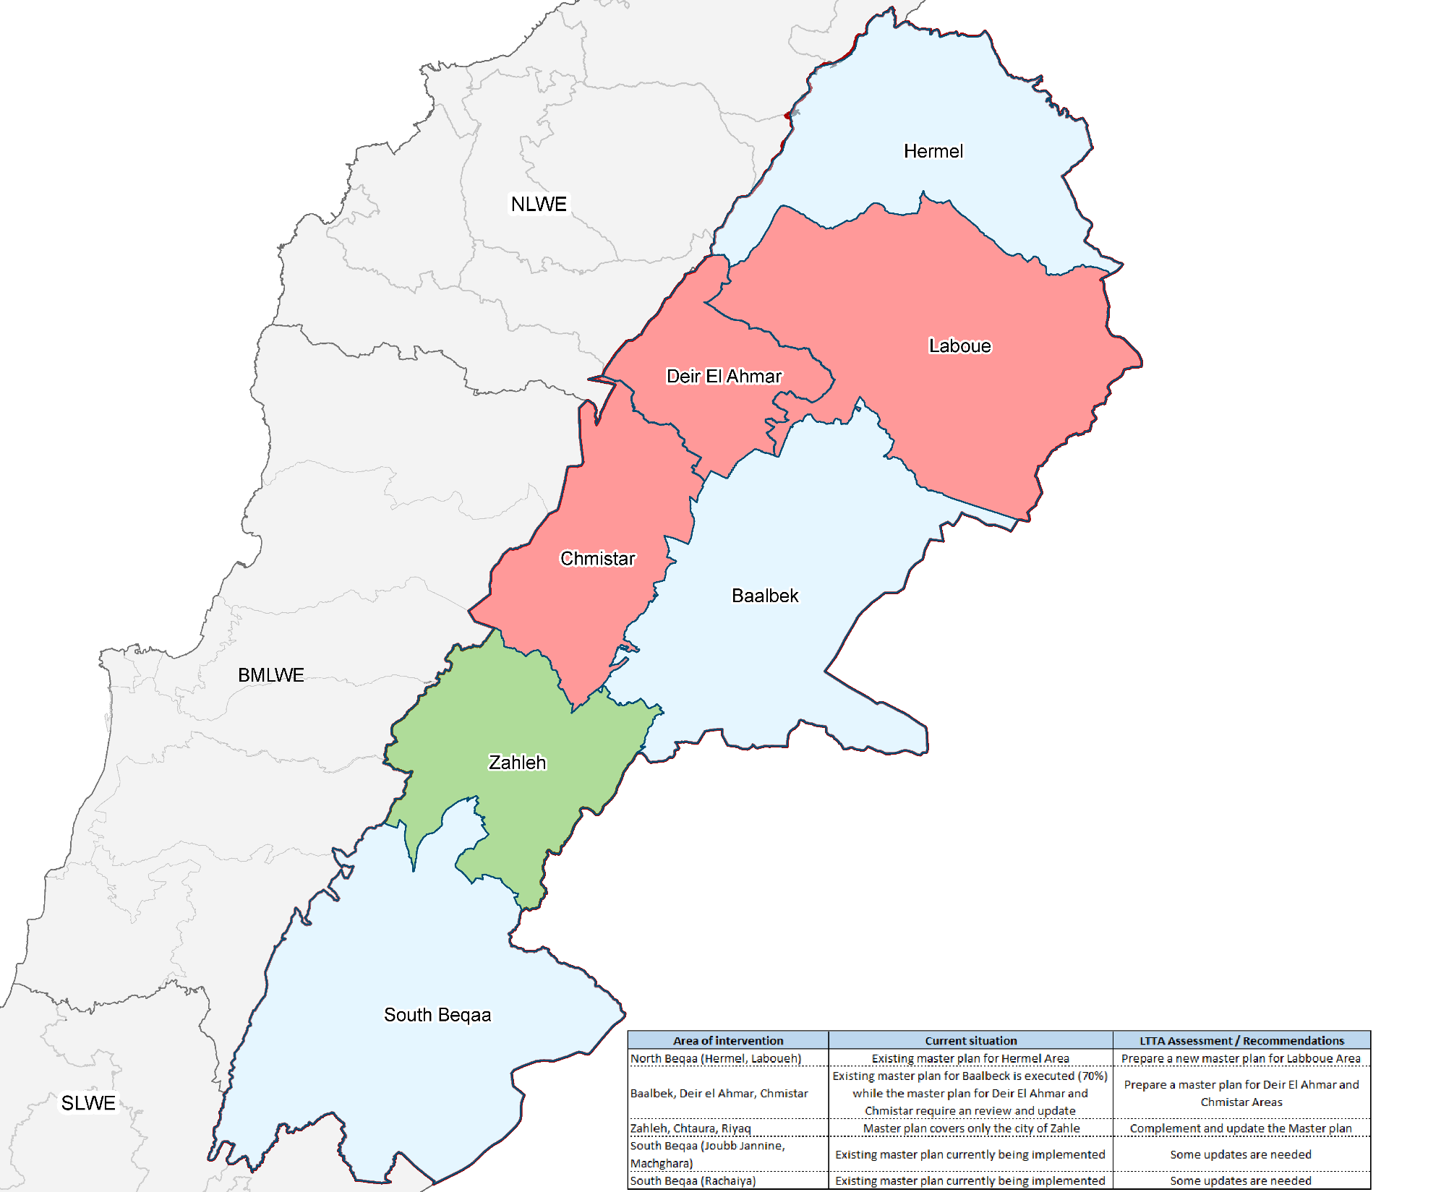

Slide 9
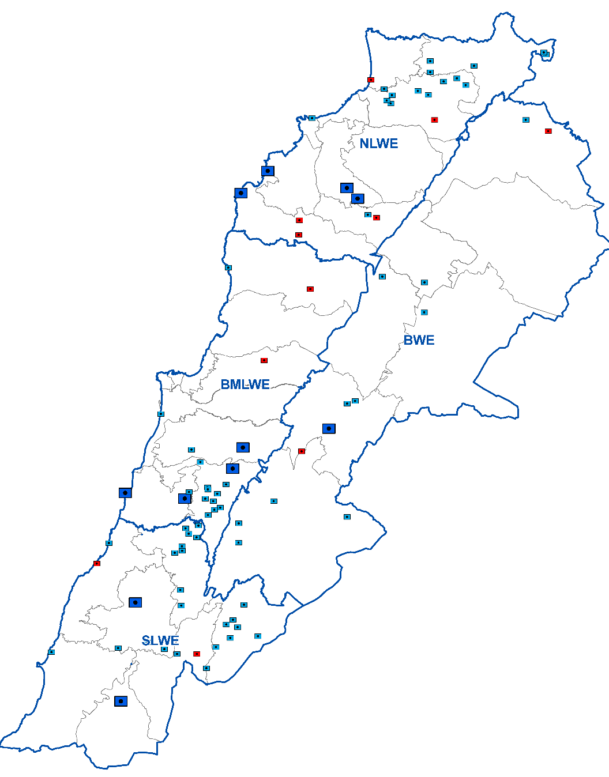




Wastewater Master Planning
O&M Requirements for 11 priority WWTPs
Assessment of O&M requirements in case of emergency total or partial shut-down
Cost per treatment stage; Possible partial shut-down scenarios; Cost of partial shut down; Impact on environment
Present situation
Actual measures are presently being implemented for the handing over of all the WWTPs to the WEs
A program is currently considered , funded by the EU and implemented by UNICEF, for the rehabilitation and then operation of a number of WWTPs
A TA programmme is currently being implemented by GIZ
Present involvement of the LTTA in the sector
Setting out an inventory of the sector's existing master plans, covering collection networks and treatment plants; and highlighting gaps and actions to address them.

Slide 10
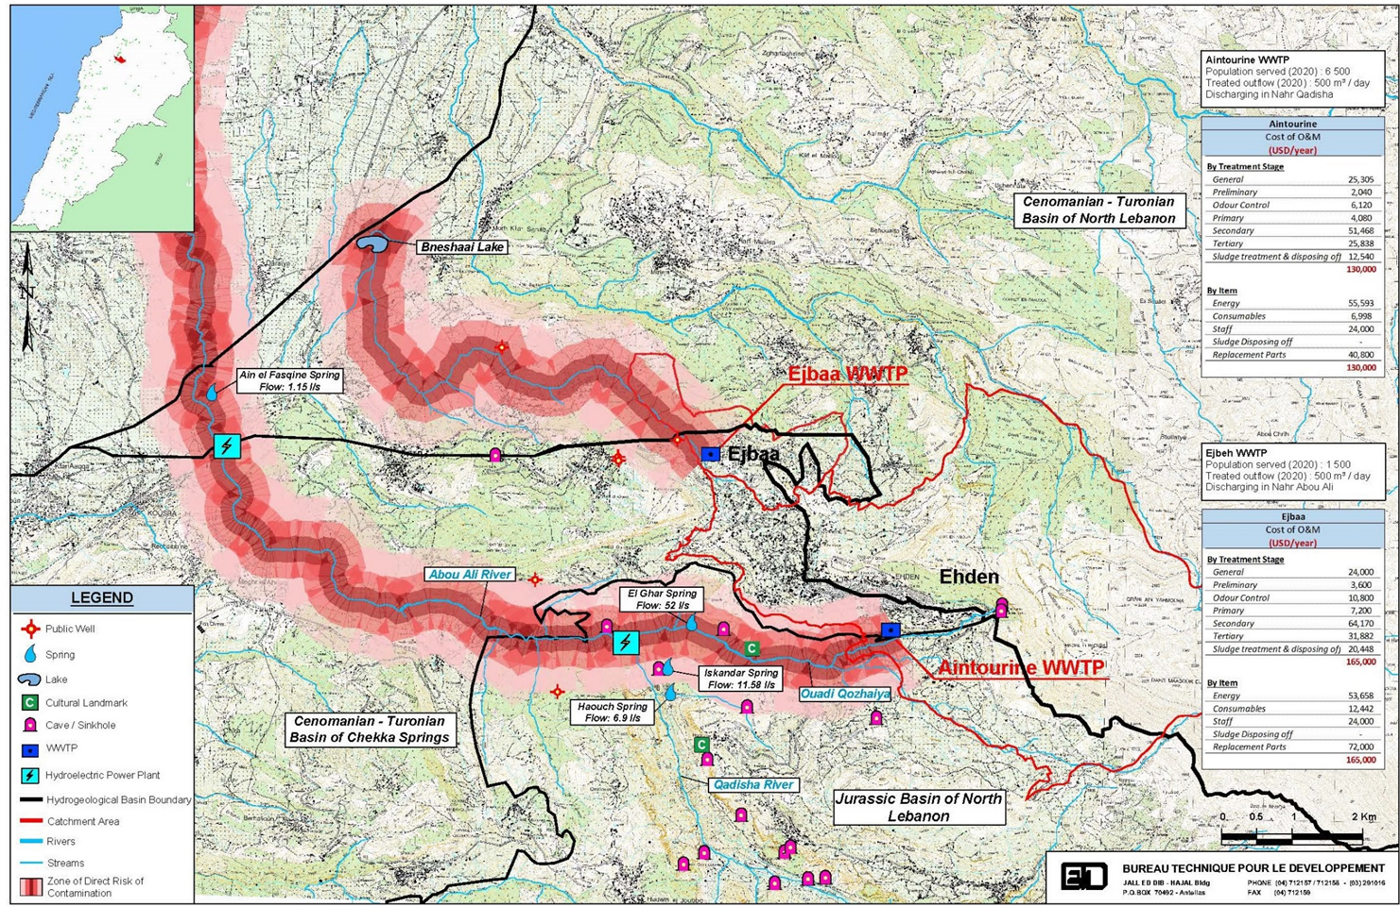

Slide 11
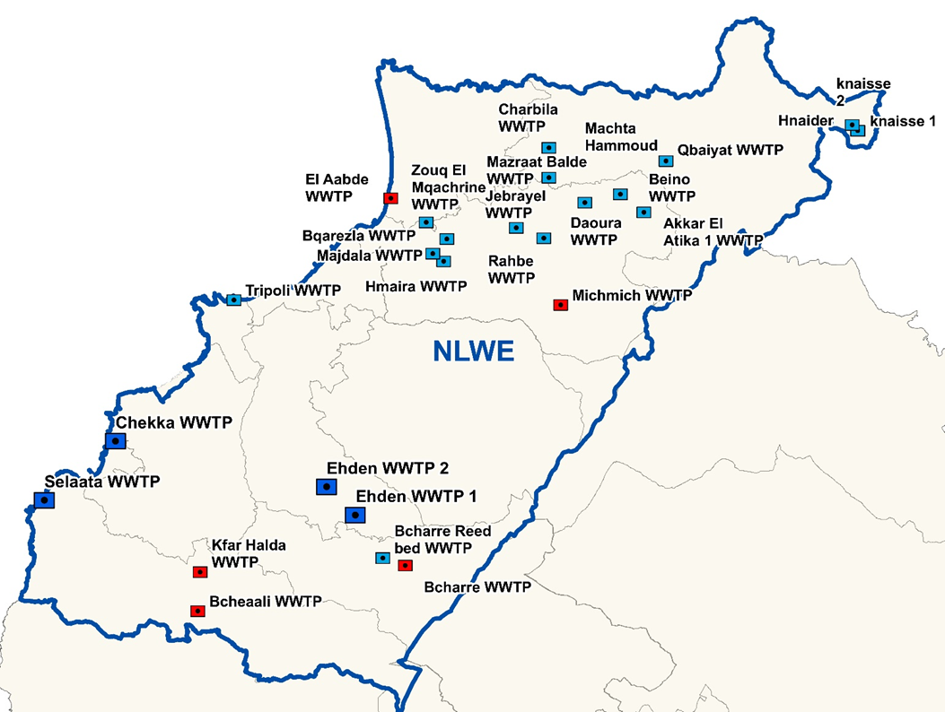

Slide 12
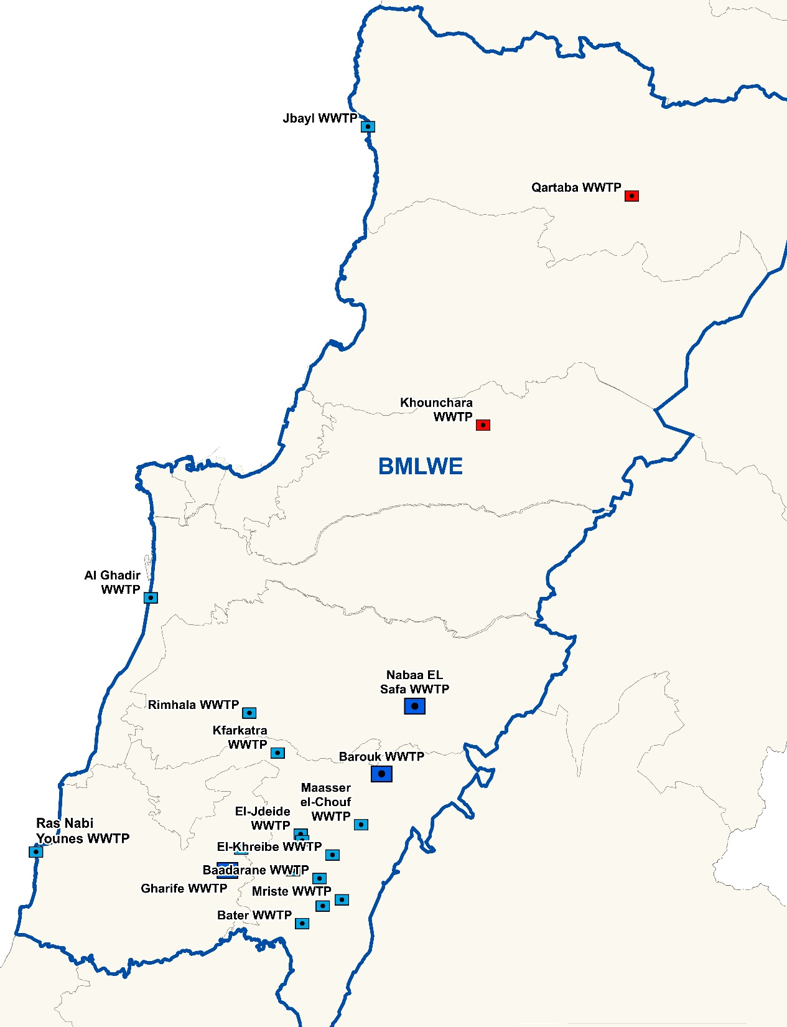

Slide 13
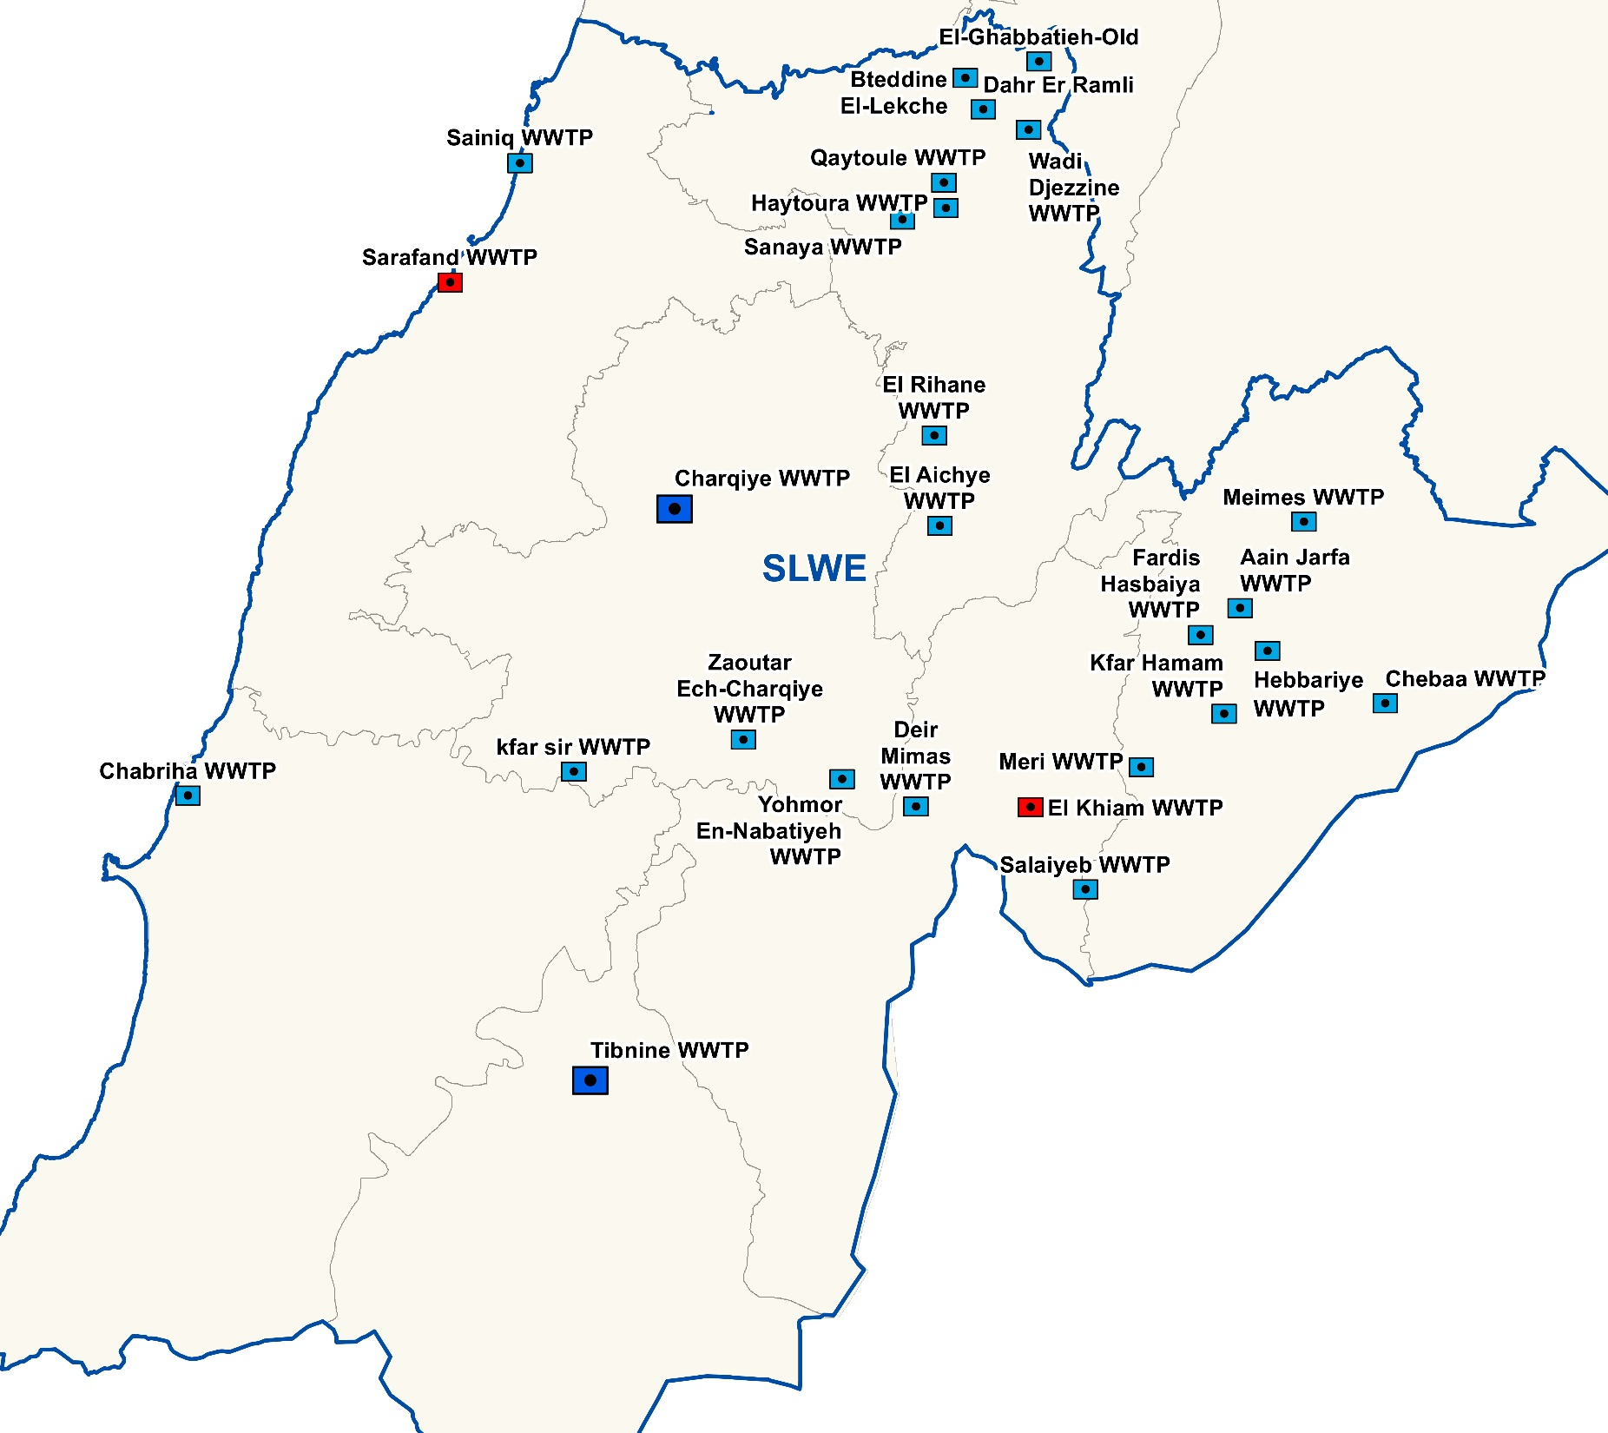

Slide 14
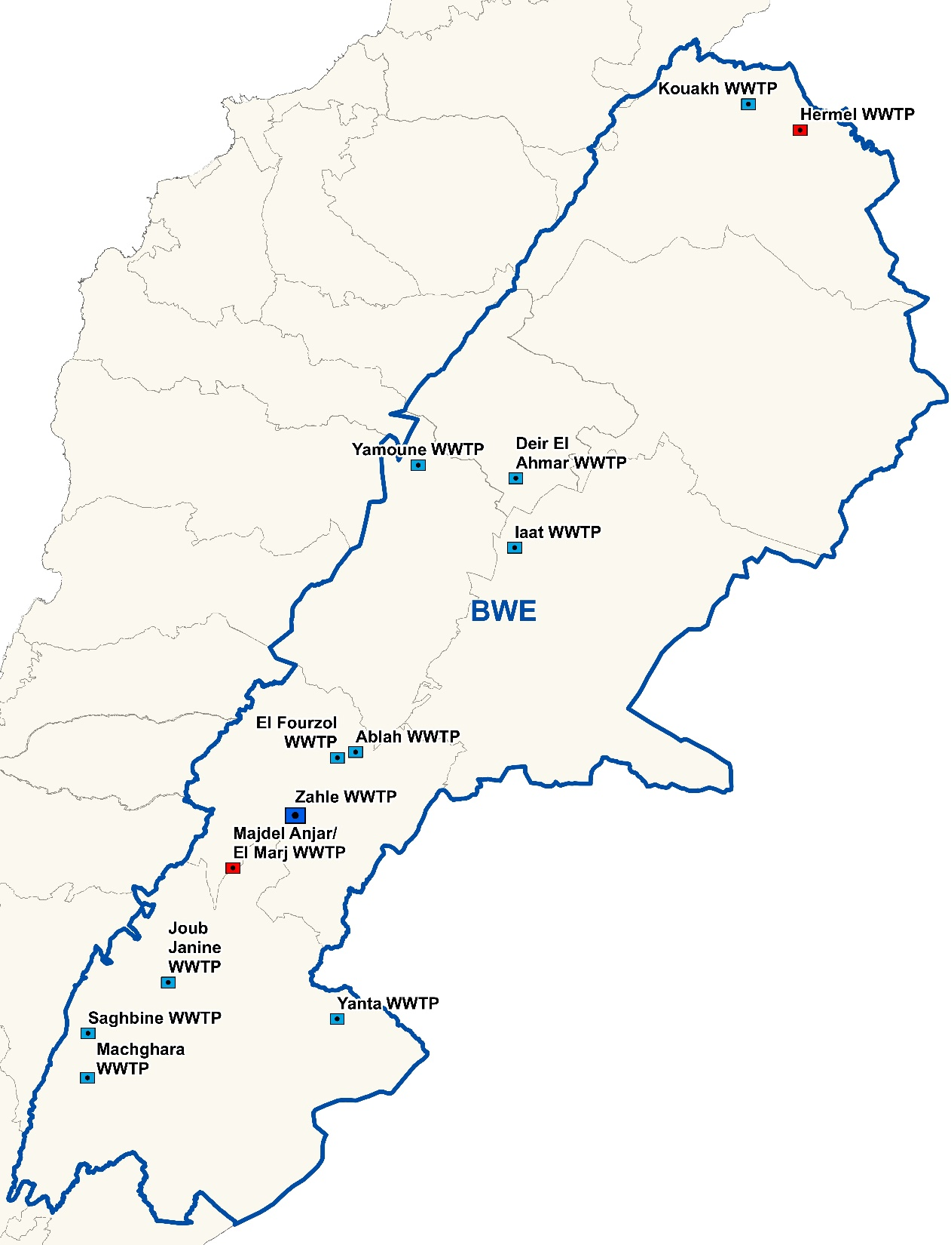

Slide 15
Metering and monitoring of water production and distribution

Slide 16
Metering & monitoring of water production & distribution
Quality of Data
Water production
Water distribution
Volumes Produced are, at best, to be considered as operators best estimate since the WEs have no reliable flow measurement devices at their production sources; and in case there is, they are not monitored properly
Except for limited areas, the actual water consumption at consumers’ level cannot be known due to the absence of metering practices and the lack of data
The volumes billed are based on subscribed volumes and not on actual metered consumption

Slide 17
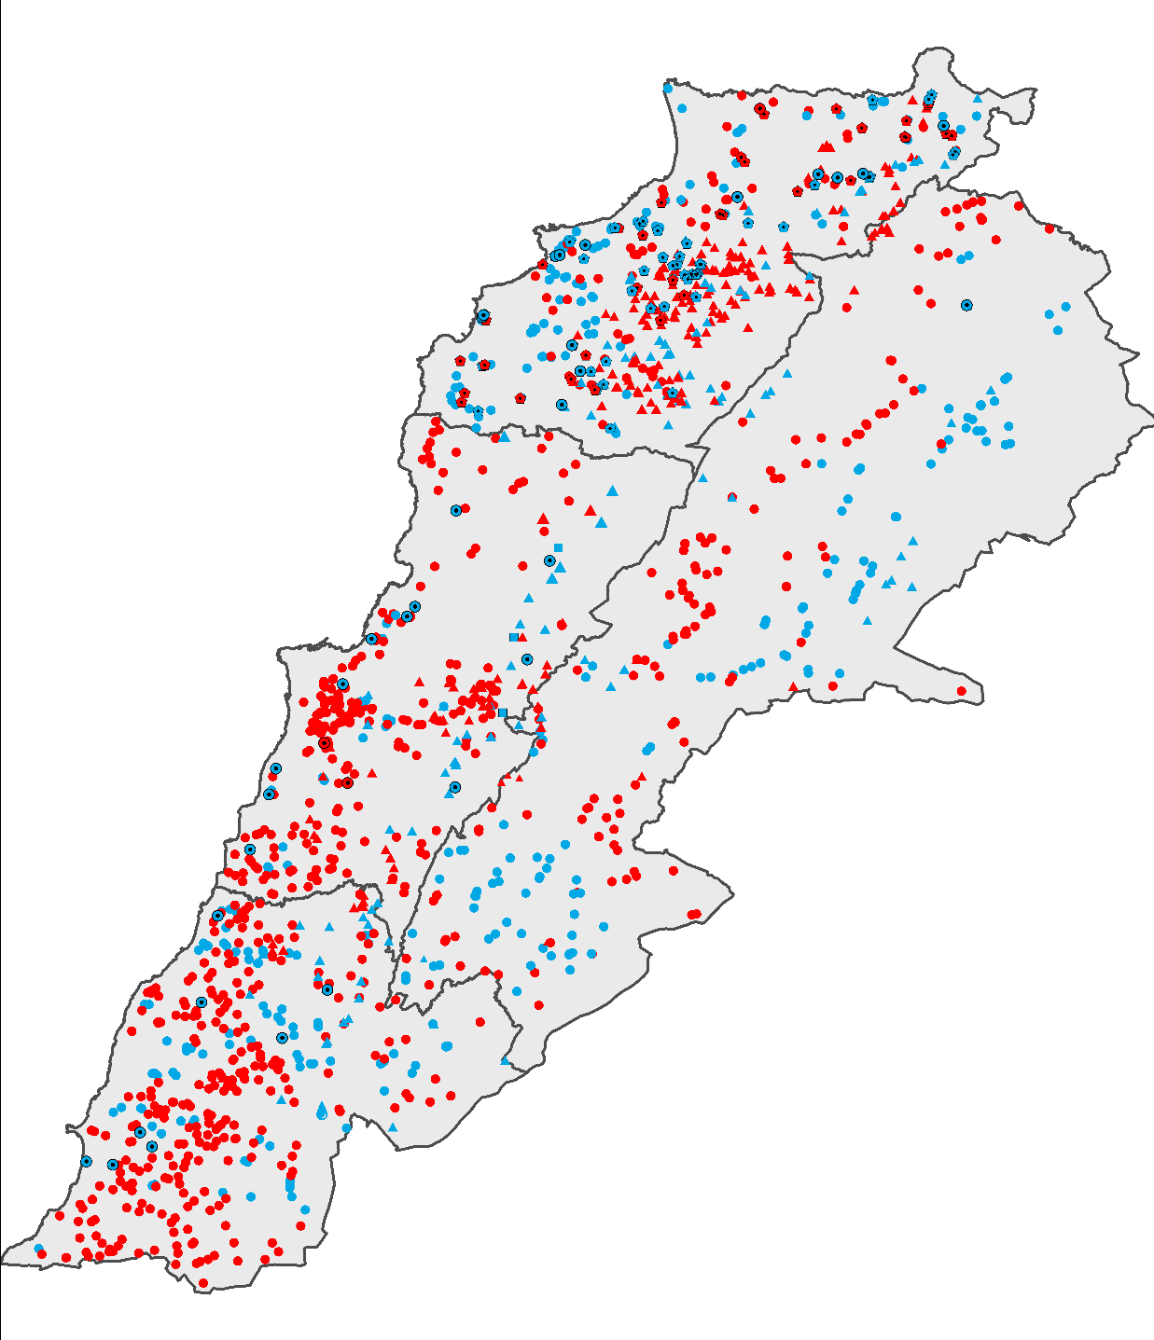
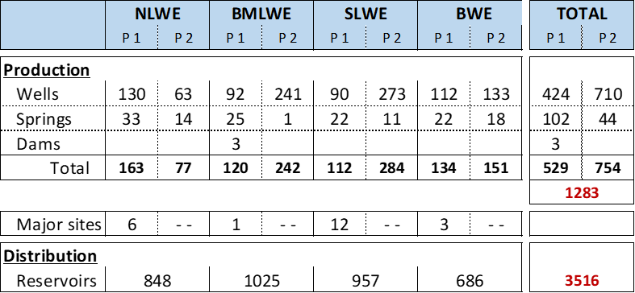
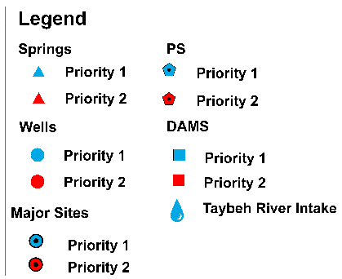
Metering & monitoring of water production & distribution
Metering of water points
Priority 1 is for main production points or central facilities, producing large volumes of water and therefore serving a significant number of population and potentially providing consistent revenues to the WE

Slide 18
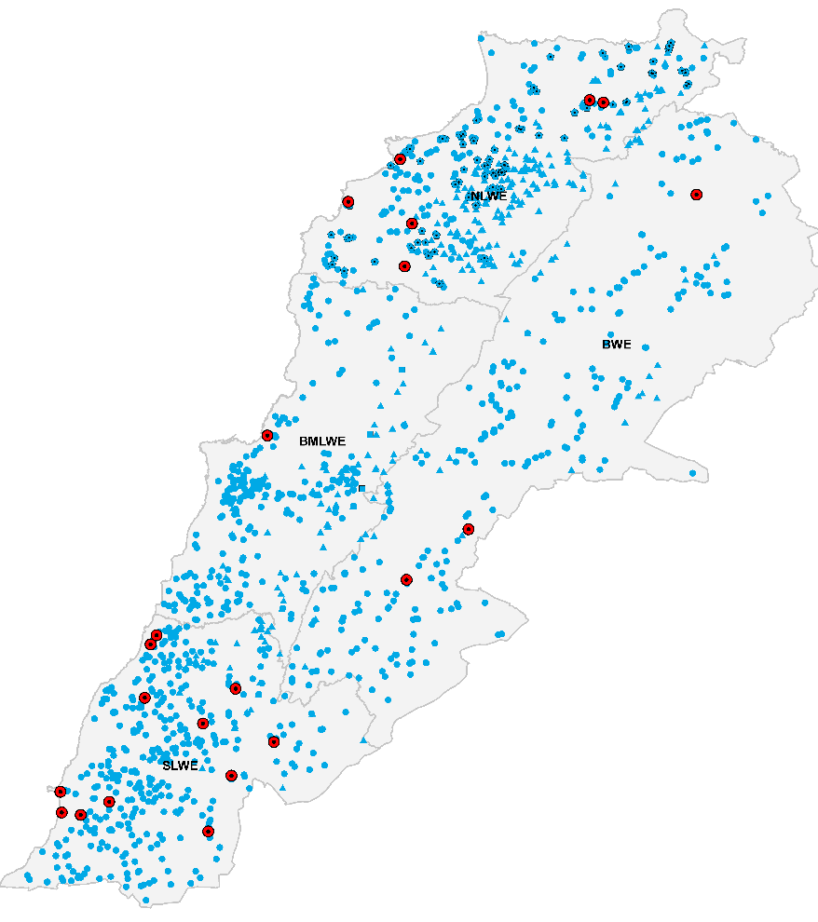
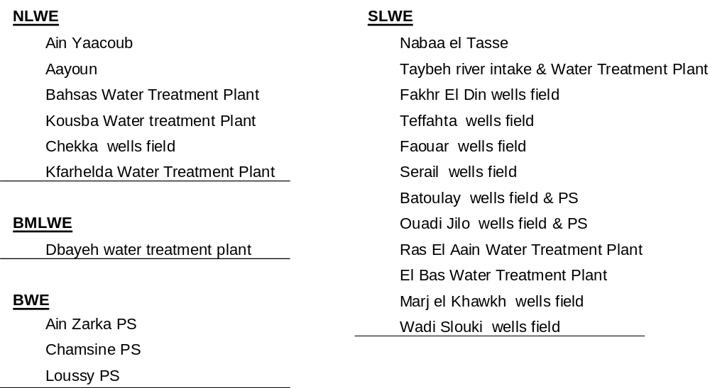
Metering & monitoring of water production & distribution
Major production sites

Slide 19
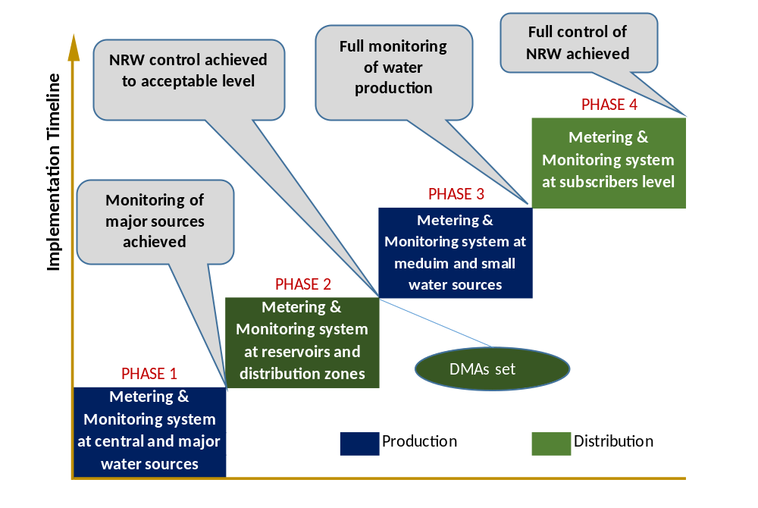
Metering & monitoring of water production & distribution
Metering as key factor for NRW management
Due to the lack of metering at consumers’ level, down-top assessment of NRW cannot be performed.
Top-down assessment is made by comparing volumes produced to volumes billed
Therefore a key data is the measurement of produced water at the source

Slide 20
Key Performance Indicators

Slide 21

Key Performance Indicators
Challenges are evolving rapidly unleashing inefficiencies across the sector
Key Performance Indicators (KPIs) provide a starting point for improving the performance in the water and wastewater sector and can lead to greater efficiency and delivery of better services.
KPIs are used to measure the progress toward achieving the strategic goals and constitute the building block of performance benchmarking.
54%
85%
35%
Utility A
Utility B
Utility C

Slide 22
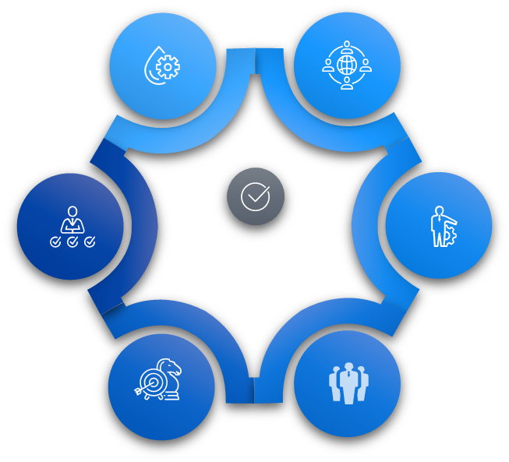
Performance Monitoring
Water Establishments
International Donors
Measurement of performance
Performance-linked funding
Baseline for business planning
Evaluation of initiatives
Ministry of Energy & Water
Service Providers
Comparative analysis of WEs
Performance-based contracting
Assessment for Tariff setting
KPI Users
Setting targets for agreements
National Water Authority
Researchers & Consultants
Evaluation of the water sector
Studies and TOR for projects
.
Baseline for strategic planning
Comparative analysis and research

Slide 23
Roadmap Performance Framework
Problems
Check the problems of existing KPIs; Propose starter set of KPIs based on international practice
Design
Design a plan; Prioritize actions based on their level of impact, cost & difficulty
Objectives
Define objective as
“Sustainability and Financial viability of WEs”
Diagnosis
Diagnose problems to root causes; Analyze each KPI according to a nine-box matrix
Doing
Implement the plan in order to progressively increase the number of KPIs
Objective-Based Performance Roadmap
Five steps roadmap where each step provides the information needed to move on to the next step and allows for setting new objectives successively higher at the finish of the performance cycle.

Slide 24
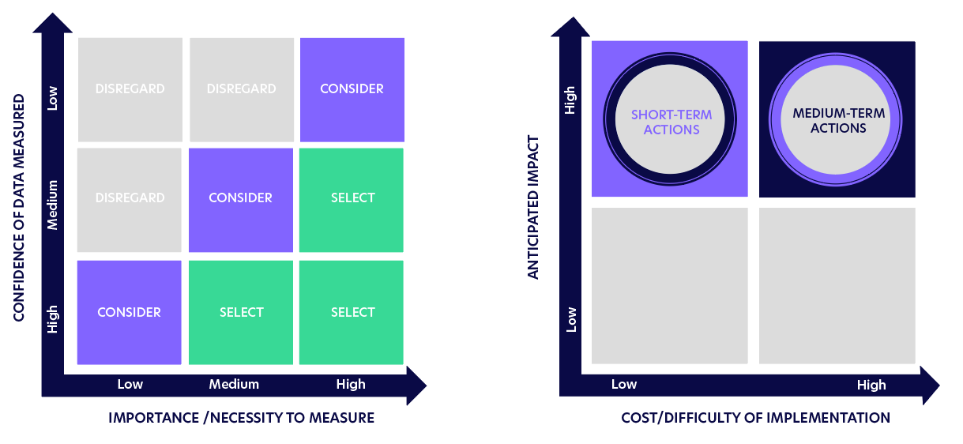
Framework Decision Tools
KPI assessment tool
Nine-box matrix
50⁺
KPIs Assessed
W & WW international KPIs
The matrix is custom developed to analyze the application risks of the international KPIs based on two variables: importance to measure and the confidence (reliability & accuracy) of the measurements. By combining these two variables, the matrix is crafted consisting of 9 different boxes with 9 different scenarios and 3 corresponding decision actions to choose from:
Select: The KPI has a precise calculation and high importance
Consider: The KPI can be used with caution (improvement required)
Disregard: The KPI has relatively low value to the set objective

Slide 25
Framework Decision Tools
Action assessment tool
Prioritization grid
20
Actions Assessed
Framework improvement actions
The gird is used in the framework to assess and prioritize specific actions in the planning process based on two variables: cost, level of implementation difficulty and impact of each action.
Top left quadrant
Actions identified as low-cost, high-impact, and relatively easy to implement in the short-term.
Top right quadrant
Actions identified as high-impact, high-cost and relatively difficult to be implemented in the medium-term plan.

Slide 26
The Reform Pathway
Sustain
the reform
Tough times weed out bad practices and make the utility stronger.
The AFD Technical Assistance Programme have initiated the transformation process towards the adoption of KPIs. The choice of goals will determine the direction and the path to reform , MoEW and WEs should reach a consensus on the priorities and objectives and make rapid decisions to maintain the dynamism
Build Momentum
Initiate
Maintain
transformation
dynamism for KPIs
Start
the Reform

Slide 27
Strategic Planning, Managing, and Monitoring Tool
Presented by Dr. Wassim Daher

Slide 28
Objective / Aim
The water establishments require:
  multi-front development and on multi-levels
  an instrument to evaluate the present position
  a method that allows for benchmarking and comparison
  a tool for an integrated operation depiction and simulation
  a strategy guide and strategy simulation
  an investment program simulator and tracker
  a strong management tool to manage and monitor the complete process and development operations

Slide 29
The Solution
A multi-dimension tool for strategic planning, managing,
and monitoring operations in a holistic approach that:
  Monitors operations on a micro and macro scale
Allows for strategic and tactical simulations
Tool
Exposes multilevel strengths and weaknesses
Links operational and international industry KPI’s

