Slide 1




EU-AFD TECHNICAL ASSISTANCE PROGRAMME TO SUPPORT
REFORMS IN THE WATER AND WASTEWATER SECTORS
IN LEBANON
Organizational diagnosis of the 4 Water Establishments: methodology and next steps
January 2023

Slide 2

01. Legal Background
Law 221- 2000 : Creation of the 4 RWEs as Public Industrial and Commercial Establishments. The law paved the way for granting each Establishment the authority to develop a proper Organization Structure that facilitates the achievement of its objectives
Law 583-2004: The recruitment process of the WEs was strictly linked to the Public Service Council
WE’s by laws in 2005: Rules of procedures, Operating Rules, Financial regulations, Staff rules and regulations, Administrative organization. The decrees have fixed the organization chart of each RWE including the number of personnel for each departments and units.
Law 46- 2017: Recruitment freeze for all public sector. Law still under application
Law 192-2020 also known as Amended Water Law confirming the activities of the RWEs. The application decrees are not issued yet
Law 244- 2021 Public Procurement Law, defining the rules and procedures for tendering process
The RWEs are submitted to the control of the MoEW (tutelage) and the MoF (budget and tariff).

Slide 3
02. Key Figures
 | BWE | BMLWE | NLWE | SLWE | TARGET
Surface area km² | 4 250 | 2 000 | 1 950 | 2 200
Population Minhab | 0,864 | 2.9 | 1.3 | 1.2
Number of households | 212 374 | 712 950 | 278 000 | 276 000
Produced volume of water Mm³/year | 53 | 221 | 94 | 136
Water distribution network length km | 4 400 | 10 000 | 6 000 | 8 000
Number of customers | 88 983 | 387 163 | 129 000 | 182 000
Contractual water volume Mm³/year | 32,5 | 141 | 47 | 66,5
Number of employees as per decree | 786 | 1121 | 1 257 | 872
Effective total number of employees including on demand | 361 | 1176 | 604 | 1 072
Ratio customers v/s households % | 41.8 | 54.3 | 46 | 65.9 | >90
Ratio volume contractual water v/s water produced % | 61 | 63.8 | 50 | 48.9 | >75
Employees per 1 000 customers | 4,02 | 3.04 | 4.46 | 5.90 | 4 to 7
Customers per km of distribution network | 20,8 | 48.39 | 21.7 | 22.68 | variable
Length of distribution network per employee km | 12,19 | 8.5 | 10.3 | 7.46 | 10 to 15
Treated water per employee m³/employee/year | 146 814 | 187 925 | 161 512 | 126 865 | >300 000
Income collected per employee LBP/year/ employee | 31 579 000 | 21 258 503 | 27 920 000 | 32 588 619 | eq expenses
Expenses per employee LBP/year/employee | 59 003 000 | 50 170 068 | 49 587 000 | 55 659 514

Slide 4
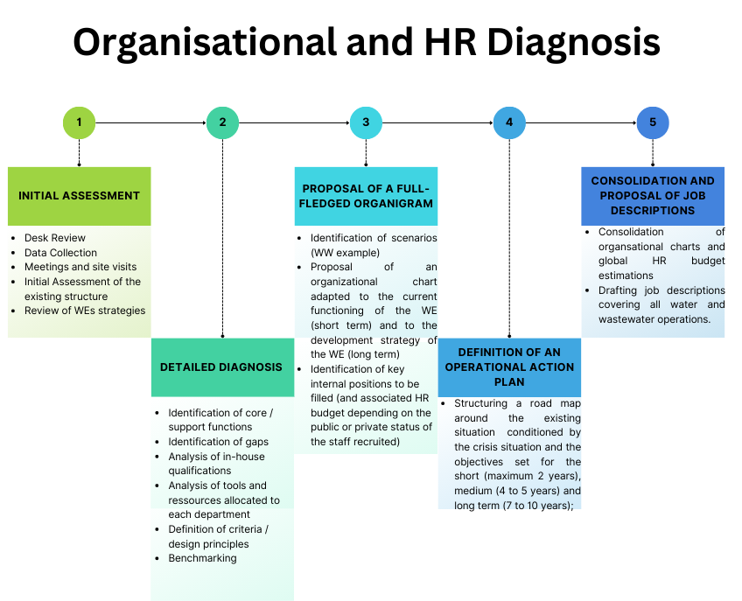
03. Adopted
Methodology (1/2)

Slide 5
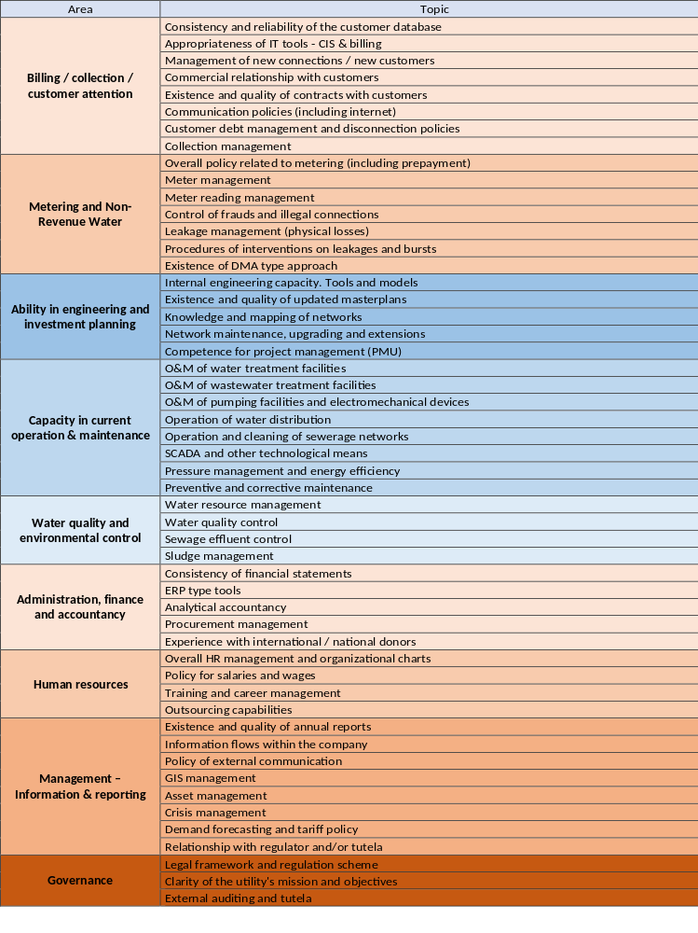
03. Adopted Methodology (2/2)
The Establishment‘s mandate and operational responsibilities have a direct impact on the organigram’s functionality.
A global target organizational chart shall be proposed for each WE. Options shall be considered complying with the orientation of the water laws and the updated water sector strategy.
The WE organizational scheme should be accordingly flexible and capable of coping and reflecting strategic goals , which can change more frequently than the structure itself.
The operational action plans and the roadmaps shall be prepared, discussed and validated by each WE.

Slide 6
04. Expected activities of WEs (laws 221 & 192)
Resources management: protection of the water resources, , follow-up of the raw water quality, supervision of the treated water quality
Management of house connections, customer service management: billing process, collection, metering strategy, quality of service (24/7), customer relation, updating customer database
O&M of potable water, wastewater and irrigation systems
HR management: wages policy, recruitment strategy, training, performance assessment, etc.
Communication: internal, external
Non-revenue water (NRW): illegal connections, disconnections, leak detection
Design and supervision, process expertise, master plans, power supply, and power optimization
Finance: expenses control, income, accounting, assets management, financial strategy, investment planning, profit & loss, annual balance
Legal: insurance, warranties, owner’s rights, laws update and compliance, water law, labor law, contracts management, etc.
Forecast of the water demand, tariffs proposals
IT: software and hardware maintenance, update, licenses management, security, telecommunication, specific software (LIMS, GIS, CMMS, SCADA etc.)
Procurement: cost optimization, products quality, new technologies
Logistics: sites maintenance (cleaning, landscaping), vehicles, buildings maintenance, HAV,
Administrative: board coordination, archives, relationships with public administration, chairman office,
Health and safety: maintenance of the safety equipment, control safety on site works, training, follow-up of accidents
Regional offices: to oversee local customer relations, O&M of local water production, and local networks.

Slide 7
05. Initial Observations
Key required activities are partially or not tackled at all in the organization charts established by decree: wastewater, irrigation, communication, health and safety, security, resources management, IT and automation, NRW.
Some support functions and activities are fragmented across existing departments (example: Customer activity, Human resources activity)
The distribution of responsibilities and tasks are not sufficiently detailed between the operational level of the WEs and the tutelage / regulation directorates at the national level.
The RWEs are still under the supervision of the central authorities in key areas:
  Not able to hire staff independently of the government’s consent, and obligation to follow the council for civil service rules and procedures which is on freeze since 2017.
  Financial independence is limited.
  Poor cost recovery (unsufficient tariffs, high NRW, and poor collection efficiency).
  Ownership of the assets to be clarified.
There are overlapping responsibilities that reduce accountability and block any performance measurement.

Slide 8
06. Next Steps
Organisational diagnosis
Draft roadmaps and action plans & legal feasibility
Amended organizational charts based on the agreed design principles
Final roadmap the action plans
Job Description
May 2023

Slide 9
Thank you
for your attention

