Slide 1




EU-AFD TECHNICAL ASSISTANCE PROGRAMME TO SUPPORT
REFORMS IN THE WATER AND WASTEWATER SECTORS
IN LEBANON
Technical and financial diagnosis of the 4 WEs
Challenges and Perspectives
January 20, 2023

Slide 2




Technical and Financial Diagnosis
Operational Diagnosis
Financial Diagnosis
Diagnosis
Recommendations
Highlights l HR l Subscribers Production l NRW l GIS l ERP
Financial Analysis
Billing Collection l Arrears
Recommendations l Actions

Slide 3


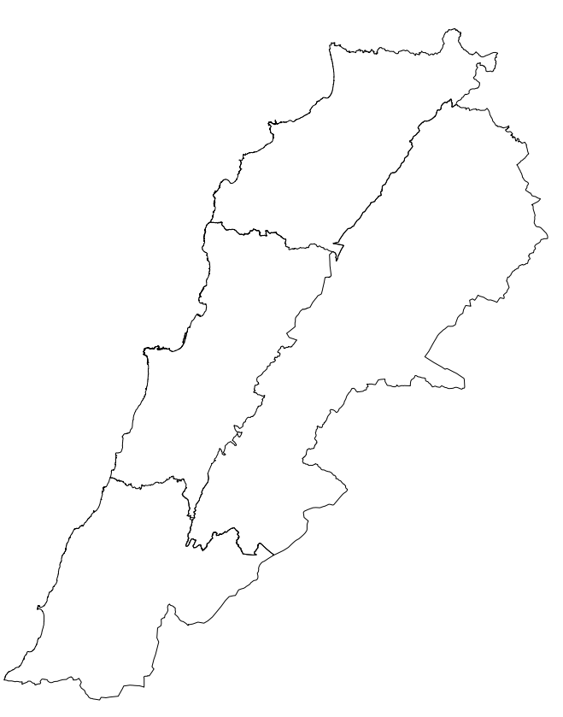
Operational Key Data
SLWE Highlights .Population 1.2 Million .Area 2,200 km²
PS 13 | Well 363 | Spring 8 | WTP 3 | WWTP 7
BMLWE Highlights .Population 2.9 Million.Area 2,000 km²
PS 398 | Well 315 | Spring 29 | WTP 12 | WWTP 15
BMLWE
SLWE

Slide 4
Operational Key Data
NLWE Highlights .Population 1.28 Million .Area 2,000 km²
PS 79 | Well 69 | Spring 153 | WTP 3 | WWTP 5
NLWE
BWE
BWE Highlights .Population 0.75 Million .Area 4,250 km²
PS 38 | Well 291 | Spring 68 | WTP 2 | WWTP 7

Slide 5
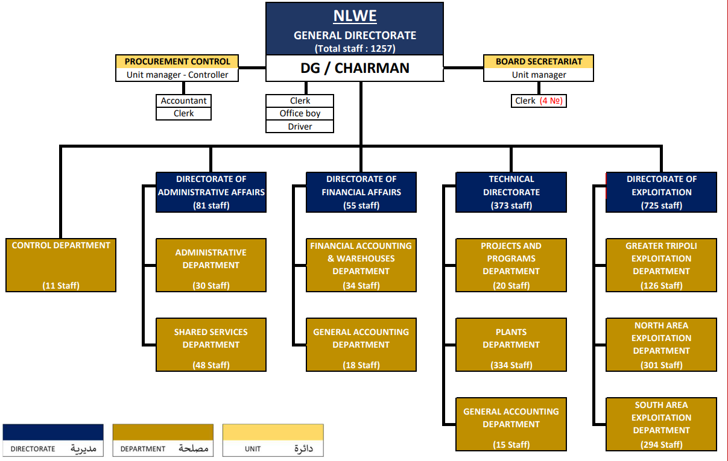
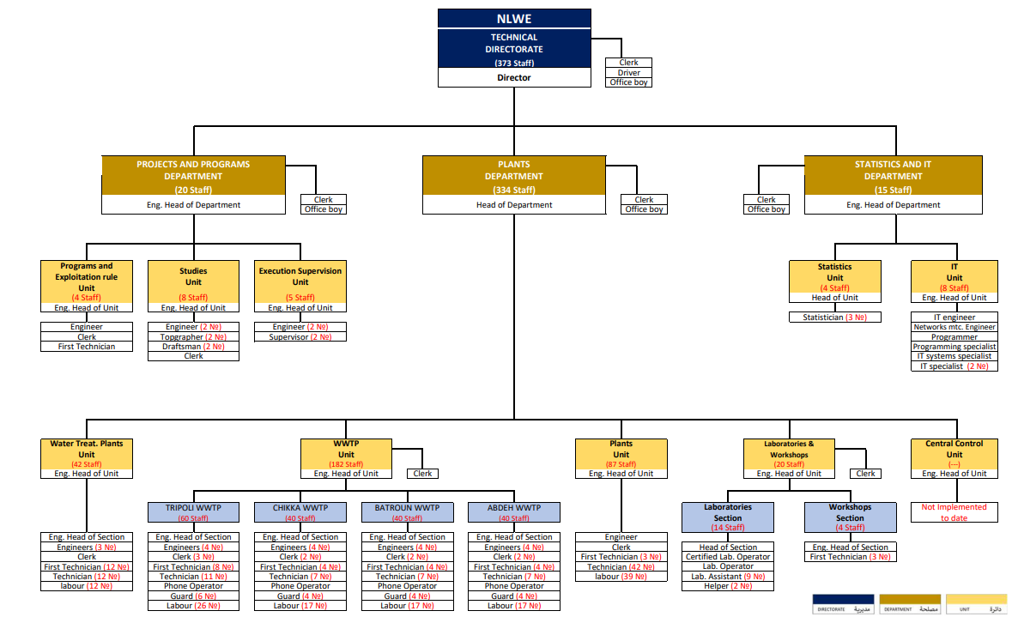
Organization Charts
Staffing as per decrees (2005)
NLWE:
1257 Staff
(By-law 14913)
BMLWE:
1120 Staff
(By-law 14915)
SLWE:
872 Staff
(By-law 14914)
BWE:
784 Staff
(By-law 14916)

Slide 6
Human Resources
Staffing
The ban on hiring results in an acute understaffing of permanent staff
Understaffing is compensated by the employment of staff on demand
Staff skills may not be to the level required by the position they fill, specially for on demand personnel

Slide 7
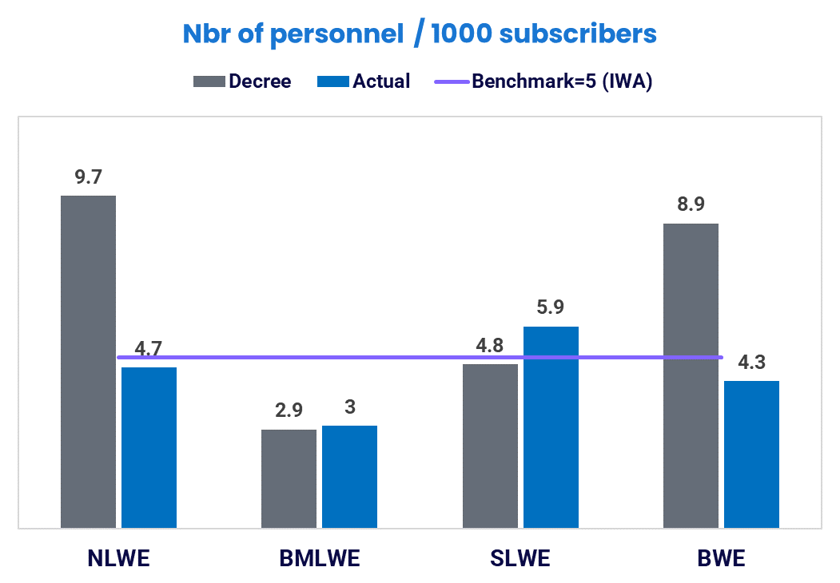
Human Resources
Benchmarking
It appears that the number of personnel as defined by the decrees is not in relation with international benchmarking
NLWE and BWE that are understaffed compared to the decree are presently up to the international benchmark
BMLWE remains sharply understaffed
SLWE is slightly above the benchmark

Slide 8
Subscribers
Trend
Subscription growth is not affected by the financial crisis
CAGR=Compound Annual Growth Rate
Applied Principles
CAGR=1.4%
By law subscriptions must not be for less than 1 m³/day, and the subscribed volume increases with the area of the premises
The rate per subscribed m³ is flat regardless of the subscribed volume
Customers segregation by category not reflected in tariff
CAGR=4.6%
CAGR=1.9%
CAGR=1.5%
Database Issues
Customer database must be cleaned from inaccuracies and adapted to the tariff policy that would enforced in the future

Slide 9
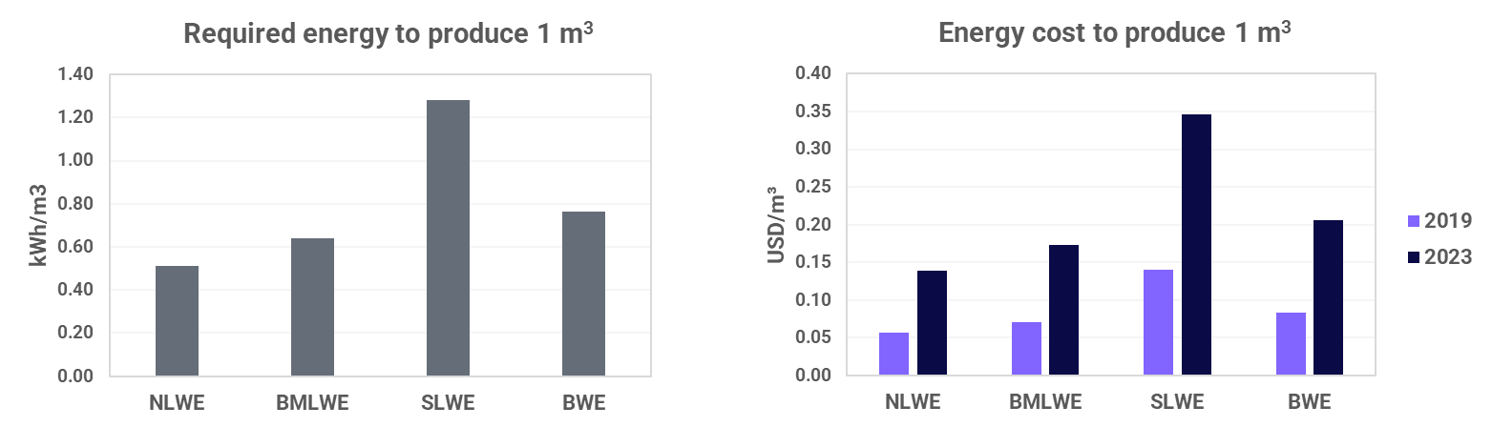
Production
Volume Produced
 | NLWE | BMLWE | SLWE | BWE
Volume produced as reported (m³/year) | 96 570 000 | 224 000 000 | 143 000 000 | 53 670 000
l/d/cap vs total population | 207 | 212 | 326 | 196
Energy Issues

Slide 10
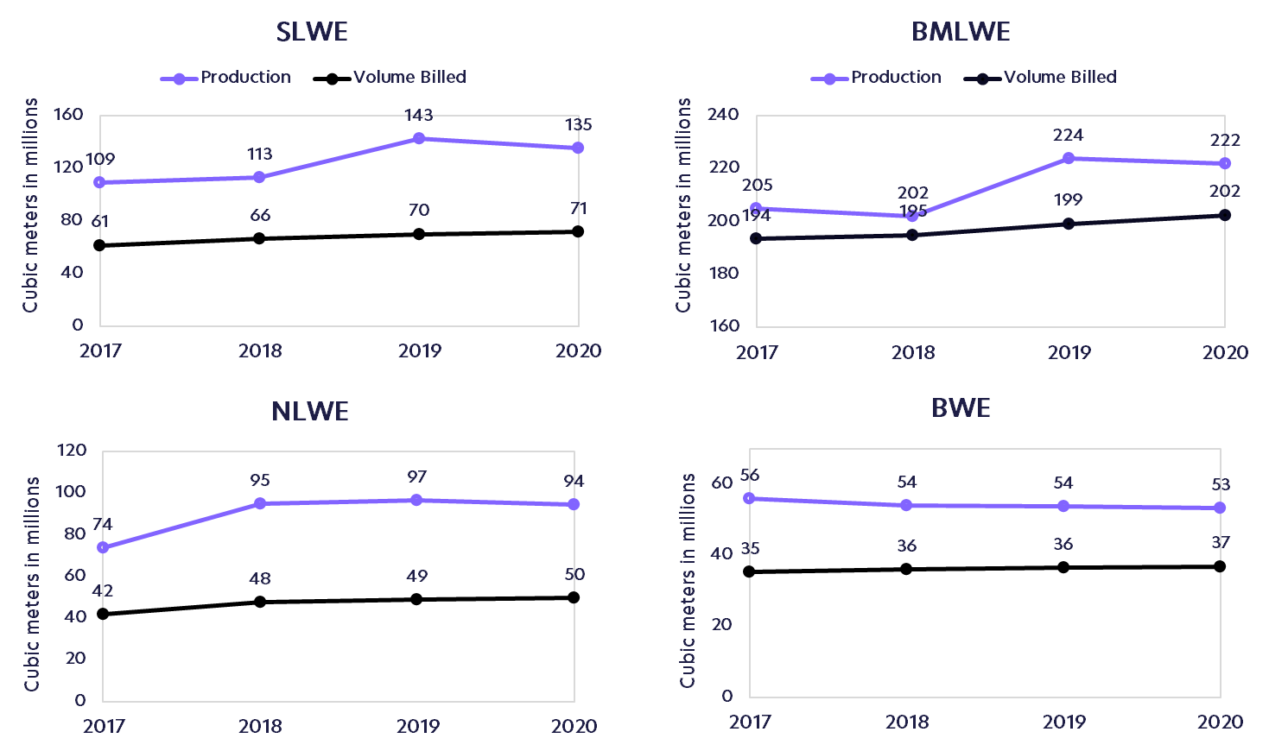
Production vs. Volume Billed
Data Issues
While the Volumes Billed are accurate as they are extracted from the WEs ledgers, the Volumes Produced are, at best, to be considered as operators best estimate since the WEs have no reliable flow measurement devices at their production sources; and in case there is, they are not monitored properly
Unbilled volume=64
(47%)
Unbilled volume=20
(9%)
Unbilled volume=44
(47%)
Unbilled volume=16
(30%)

Slide 11
Non-Revenue Water
Data
Except for limited areas, the actual water consumption at consumers’ level cannot be known due to the absence of metering practices and the lack of data. Therefore bottom-up analyses cannot be performed
NRW is assessed top-down by comparing produced vs billed volumes
Analysis
Calculation, based on international practice combined with local context, shows that physical losses do not exceed 10 to 15%
High NRW levels are mainly caused by commercial losses. The lack of data coupled with absence of DMAs compromises the accuracy of the results

Slide 12
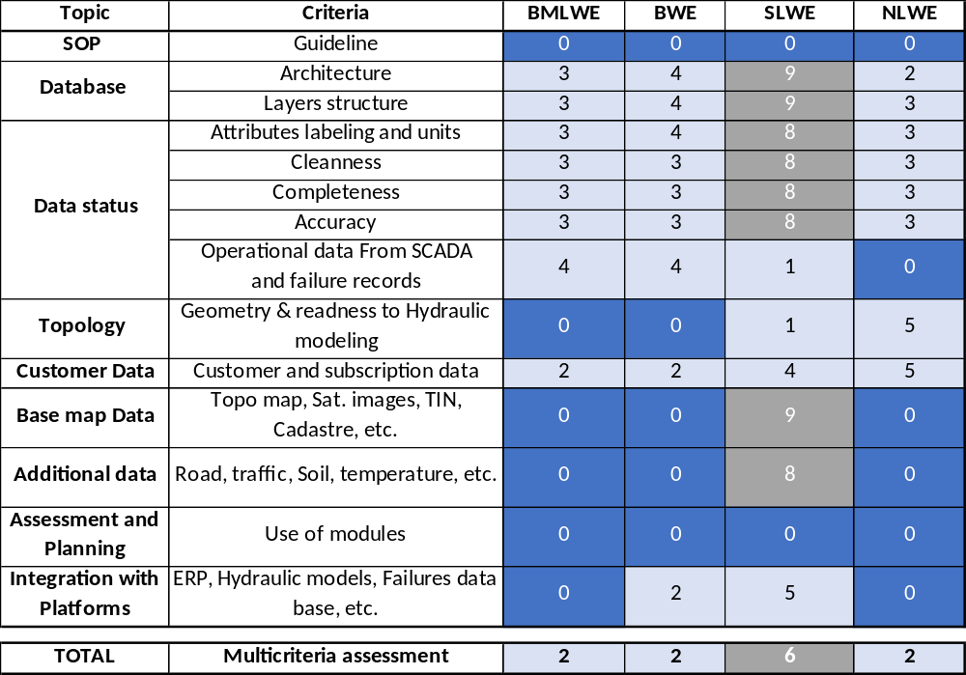
GIS Assessment
Decision support tool for water management & planning
Main findings
No Guidelines, SOP
No exchange and links with the different platforms used by the WEs (ERP, Call center, SCADA, etc.)
Structure and architecture issues
No design objective (Storage, operation, planning, accuracy, data requirements, etc.)
Attributes, labels, units, etc. issues
Codification is not addressed/Partially in 2 WEs
Geometric problems of pipes
Operational data partially included
Layers and data related to subscribers, readings valves are not well designed.

Slide 13
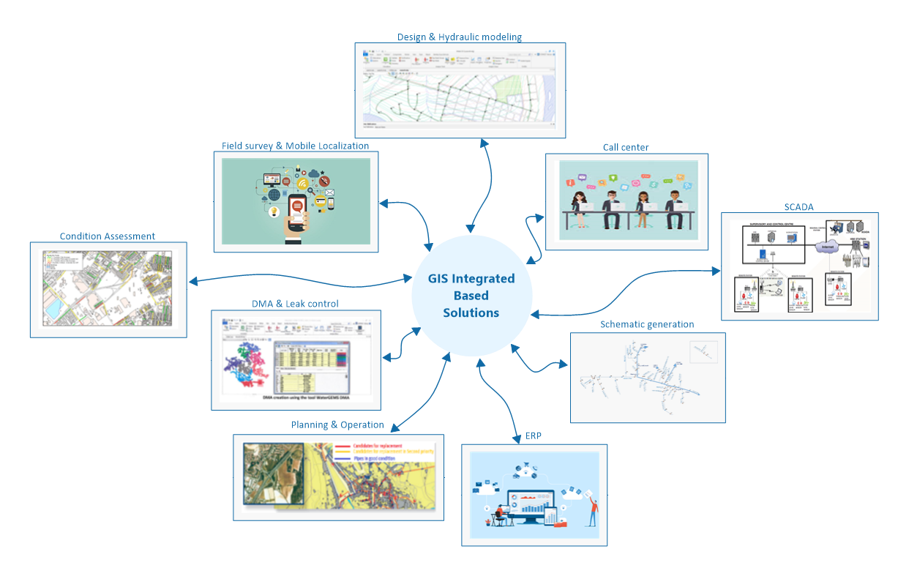
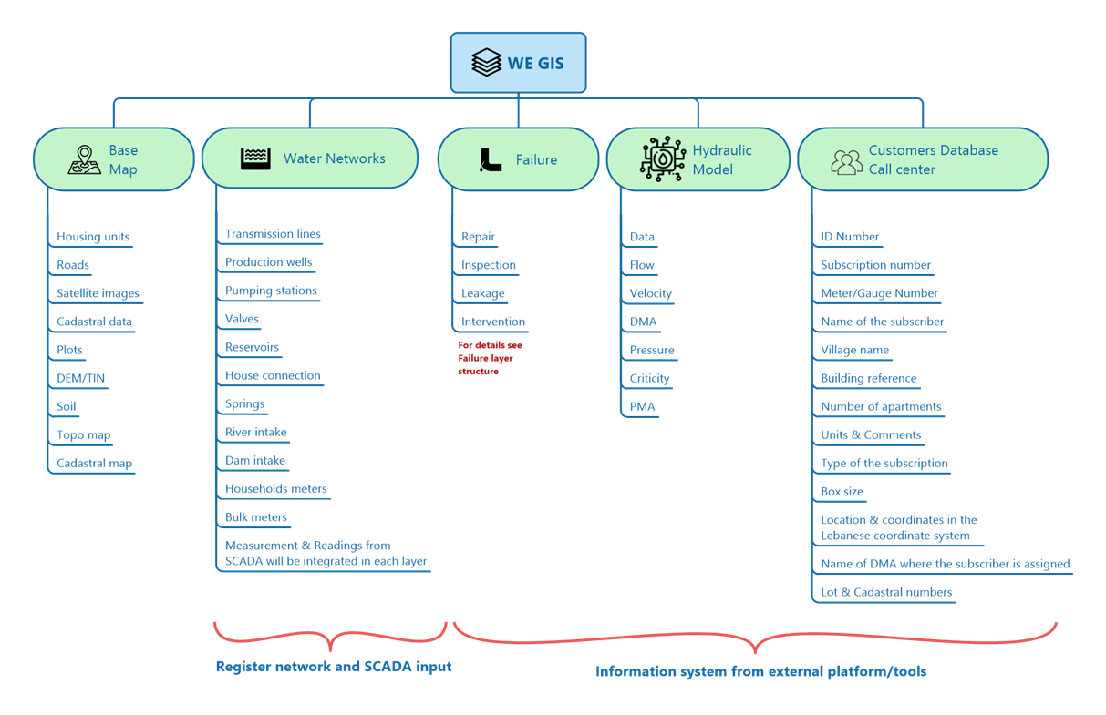
GIS Design Approach
GIS integrated based solutions
Recommended Architecture (Centralized)

Slide 14
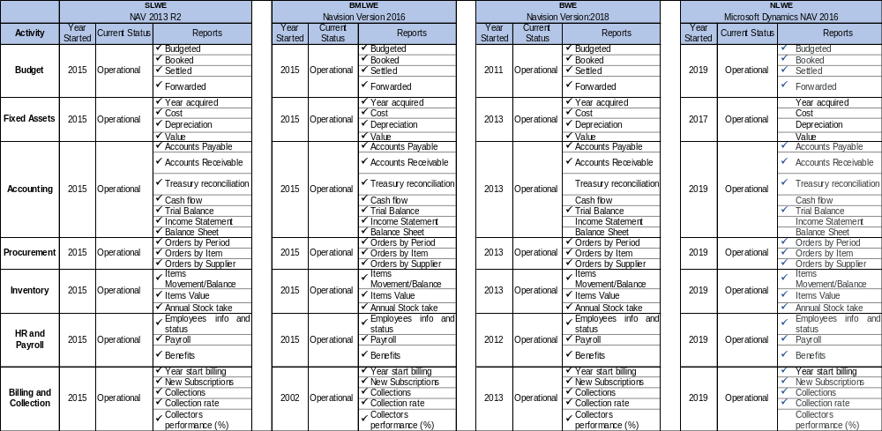
Enterprise Resource Planning

Slide 15
Enterprise Resource Planning
Main Findings
All modules are implemented but involve developer intervention for standard parameter modifications.
Standard Accounting reports require developer assistance to produce accurate results : Payroll – Billing and collection – Income and expenses statement.
Balance sheets are incomplete, main gaps refer to inventory of fixed assets, outstanding debt, stock control but includes accounts receivable and payable.
Requires GIS interface for identifying cost centers and integration with the SCADA system.
Need to have in house development to support employees, resolve programming issues, and ensure accurate and timely financial reports generation.

Slide 16
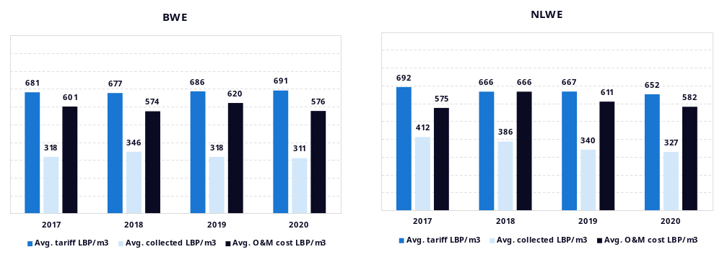
Cost and Price receivable of 1 m3
Analysis: BWE & NLWE
O&M cost (including energy) higher than the collected official price without accounting the impact of the financial crisis and devaluation of the local currency
Costs cannot be recovered based on the collection for the tariff between the year 2017-2020

Slide 17
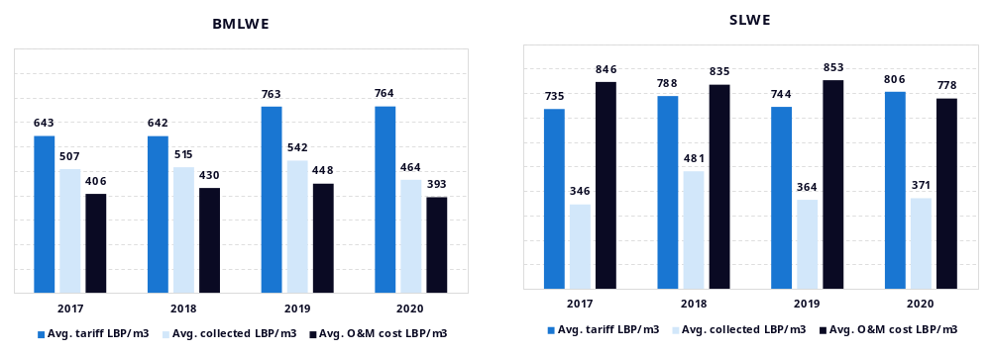
Cost and Price receivable of 1 m3
Analysis: BMLWE & SLWE
The collected official price is higher than the O&M cost for BMLWE prior to the economic meltdown between the year 2017-2020

Slide 18
Finance
Book keeping arrangements
None of the 4 WEs has comprehensive balance sheets recording assets and liabilities, some have partial records with assets registry incomplete or statement of revenues not properly recorded.
The same applies to stock management and control. None of them is audited on regular basis.
For the time being, WEs are maintaining in parallel an administrative accounting system and a commercial one causing a duplication of efforts.
Methodology used
Analysis concentrated on profitability, liquidity and solvency with focus on EBITDA (Earnings Before Interest, Tax, Depreciation & Amortization)
EBITDA is a key metric that reflect the profitability of the business together with the capacity to produce sufficient cash-flow. Such concept refers more or less to the French “Marge Brute”

Slide 19
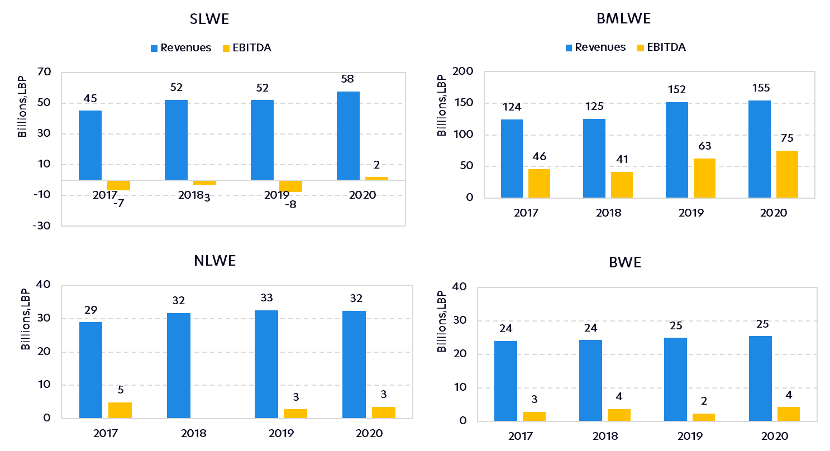
Receivable Revenue vs. EBITDA
With the exception of SLWE, all the WEs have positive EBITDA

Slide 20
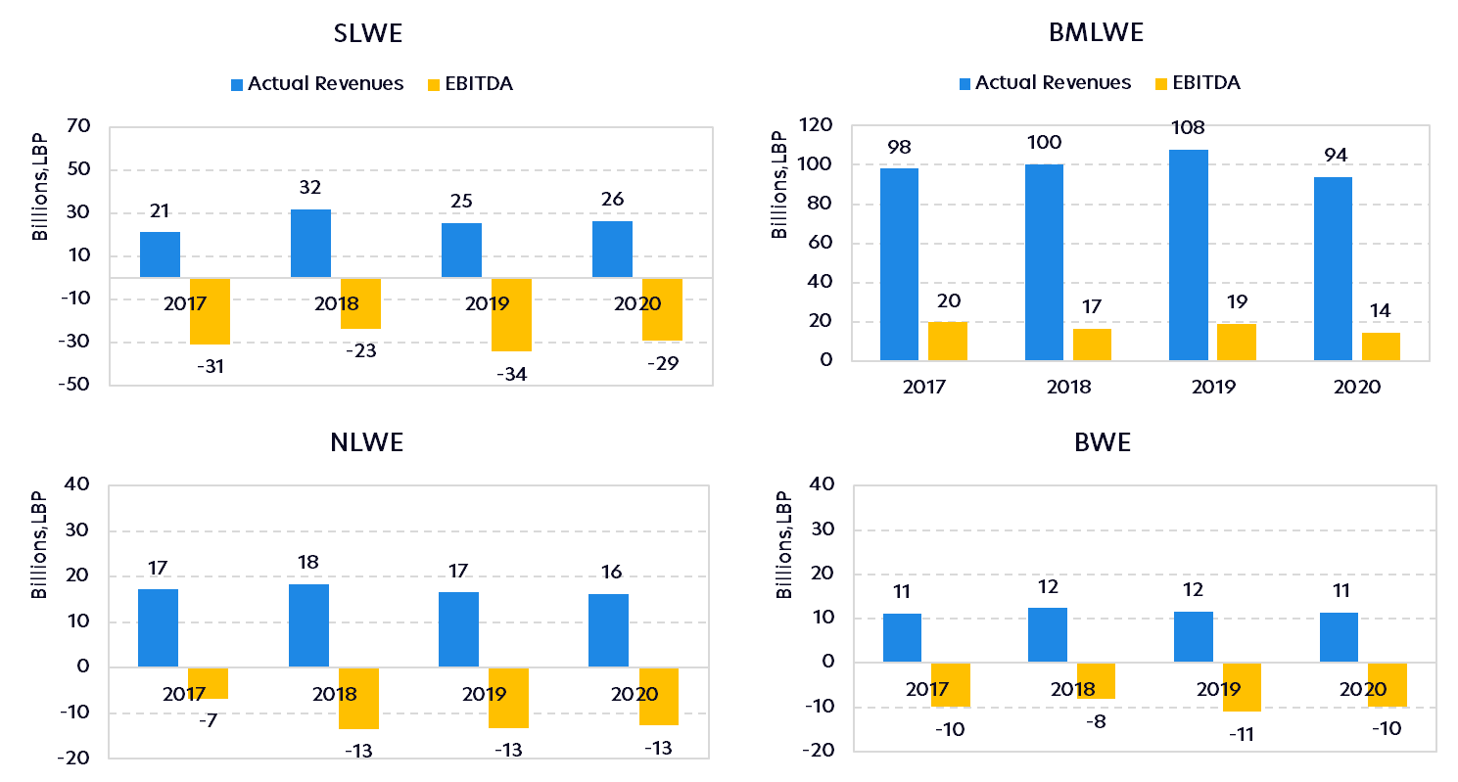
Actual Revenue vs. EBITDA
Analysis
With the exception of BMLWE, all WEs have negative EBITDA due to poor collection rate
In all cases, the trend affecting the EBITDA is going down
We are in situation where the revenues are not increasing compared to rising O&M costs

Slide 21
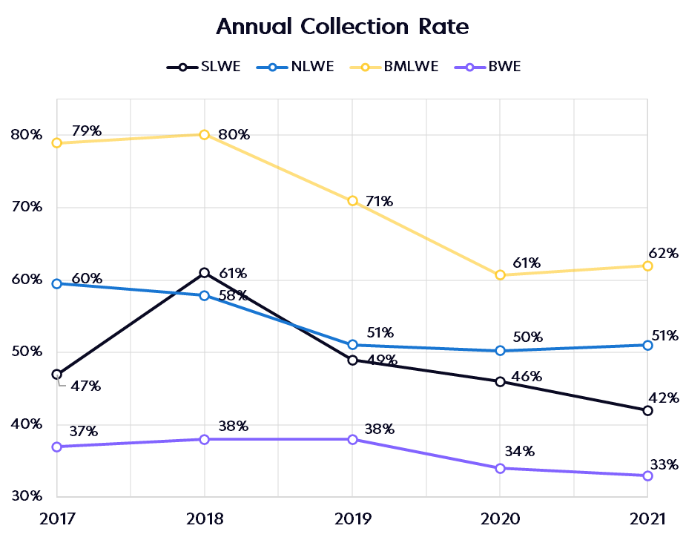
Billing Collection
The trend indicates a decline of the collection rate starting from 2019 to 2021
The accounts receivable are accumulating and the trend is not favorable on the long run
BMLWE
NLWE
SLWE
WEs are suffering of treasury problems due to inefficiency in the collection of revenues
BWE

Slide 22
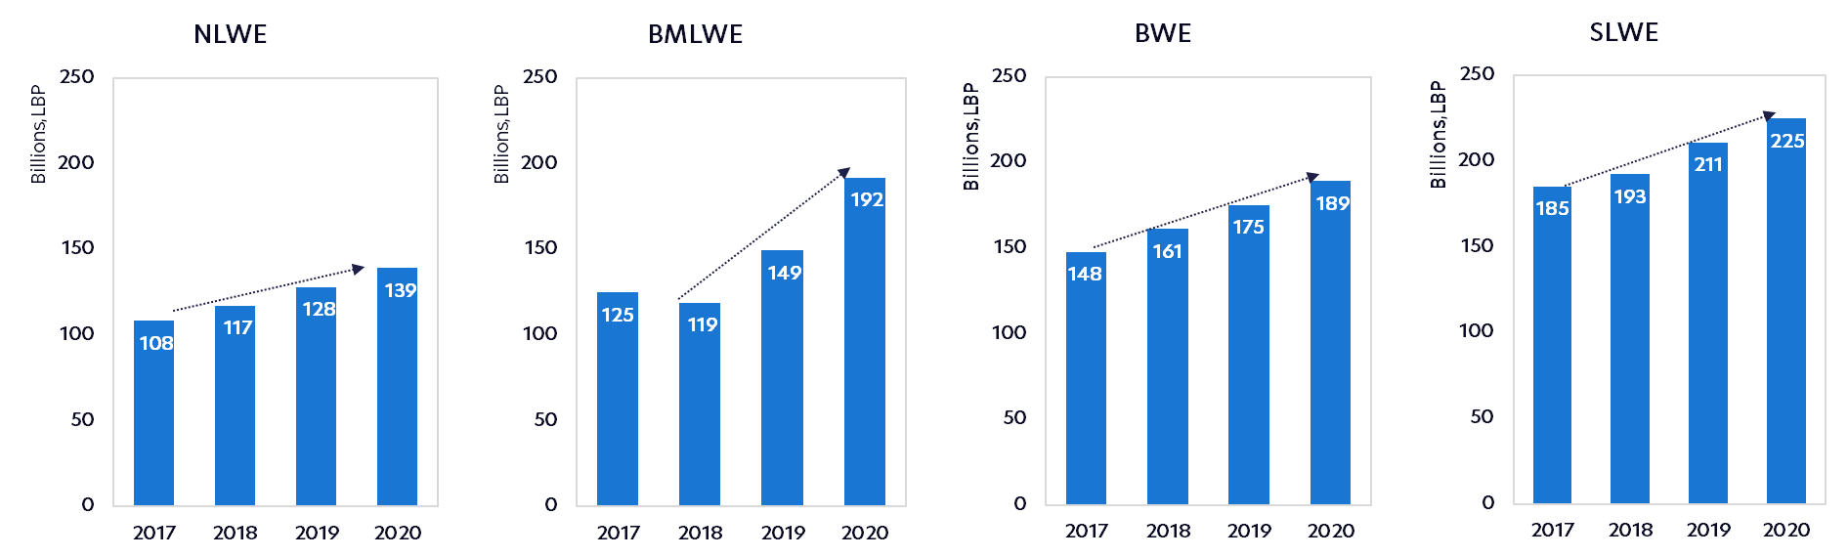
Accounts Receivable (Arrears)
The accounts receivable increased between 2017 and 2020 and the bad debt will require a provision for unpaid bills
Accounts receivable is 4 times the annual turnover for NLWE and SLWE and 7 times for BWE!

Slide 23

Key Recommendations
Generate reliable data and use of
monitoring tools for analytics
Develop tools and standards to improve processes and performance
Identify short-term actions with impact on the WEs’ financial sustainability

Slide 24
Key Recommendations
Human Resources
Assess the pertinence of the present organigrams and internal organization of WEs
Initiate necessary legal steps in order to implement a modern organization structure
Subscribers Database
Clean the inadequate customer records from inaccuracies, update the customer database and conduct customer door to door surveys
Data Generation
Introduce a reliable data collection mechanism
Focus on digital transformation of the processes to improve data integrity, operational real-time analysis as well as WE’s predictive capabilities

Slide 25
Key Recommendations
Planning
Carry out necessary studies for master plans for the areas not already covered and assess the impact of the suspension of major water production projects.
Set up standard GIS architecture and implement it as the core information system for efficient planning
Non-Revenue Water
Assess the status of the existing flow measurement equipment on all water sources with distribution zones
Improve data reliability in terms of production, consumption data to control NRW
Define and enforce clear policy for illegal connections
Gradually implement DMAs and carry out detailed studies within the targeted areas
Key Performance Indicators
Improve the monitoring framework of the WEs at central level (performance monitoring of the WEs through KPIs, etc.)

Slide 26
Key Recommendations
Tariff
Undertake tariff structure studies and propose comprehensive tariff reform structure
Accounting
Provide assistance to the 4 WEs (through an accounting firm) to produce on a regular basis financial statements that complies with the IFRS Standards.
Conduct an asset inventory and valuation

Slide 27


Ongoing/Upcoming Actions for WEs
Organizational and HR roadmap of water establishments
Digital Enterprise Transformation - focus on SLWE
Development of the performance framework between the WEs and MoEW
Organizational Managerial
Diagnosis of the legal prerequisites for the proper implementation of the updated Sector Strategy and the empowerment of WEs
Definition of the modalities for public-public delegation agreements (between WEs and municipalities)
Legal

Slide 28


Ongoing/Upcoming Actions for WEs
Cost recovery and tariff simulation
Propose tariff reform structure
Update of customer database (correct anomalies and introduction of categories)
Define target zones and relevant protocols for conducting a systematic customer census
Financial
Commercial
Metering and monitoring of water production and bulk distribution
Restructure and implement the GIS as a planning tool
Preparation of Aley Chouf master plan
Technical

Slide 29
Thank you
for your attention

